Slide 1
ECDC data/guidance on migrant health and infectious diseases
Teymur Noori
European Centre for Disease Prevention and Control (ECDC)
TBEC
20 April 2021

Slide 2
Outline
ECDC epidemiology of infectious diseases among migrants in the EU/EEA
HIV
TB
Evidence-based guidance on screening and vaccination of infectious diseases among newly arrived migrants in the EU/EEA
Vulnerabilities and impact of COVID-19 in migrants and ethnic minorities in the EU/EEA

Slide 3
Putting migrant health and infectious diseases in context
512 million persons living in the EU-28 in 2017 (1st January)*
Migrants are disproportionally affected by some infectious diseases:
> 40% of all HIV diagnoses in the EU in any given year
> 30% of all TB diagnoses in the EU in any given year
> 25% of hepatitis B and C diagnoses in the EU in any given year
Some sub-groups of migrants have significantly lower vaccination rates compared to the general population
Some sub-groups of migrants & asylum seekers are over represented when it comes to multidrug-resistance bacteria compared to the general population
57.3 million foreign-born (11.2%)*
36.9 million born outside the EU-28 (7.2%)*
Health issues
*Eurostat: https://ec.europa.eu/eurostat/statistics-explained/pdfscache/1275.pdf

Slide 4
Surveillance of infectious diseases among migrants in the EU/EEA

Slide 5
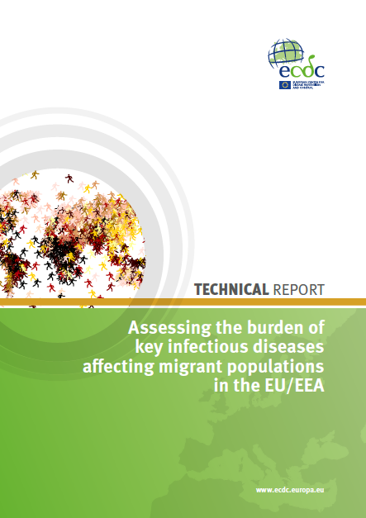
Burden of infectious diseases among migrants 2014
Objective: To produce a comprehensive overview of the key infectious diseases affecting migrant populations in the EU/EEA
TB | Rubella
HIV | Gonorrhoea
Hepatitis B | Syphilis
Hepatitis C | Malaria
Measles | Chagas disease

Slide 6
Migrant related variables collected through The European Surveillance System (TESSy)
Variable | HIV | TB | HBV | HCV | Gonorrhoea | Syphilis | Measles | Rubella | Malaria | Chagas disease*
Country of birth
Country of nationality
Probable country of infection
Imported
Region of origin
ECDC. Assessing the burden of key infectious diseases affecting migrant populations in the EU/EEA. Stockholm: ECDC; 2014.
*Not under EU surveillance
ECDC. Assessing the burden of key infectious diseases affecting migrant populations in the EU/EEA. Stockholm: ECDC; 2014.

Slide 7
Migrant related variables collected through The European Surveillance System (TESSy)
Variable | HIV | TB | HBV | HCV | Gonorrhoea | Syphilis | Measles | Rubella | Malaria | Chagas disease*
Country of birth
Country of nationality
Probable country of infection
Imported
Region of origin
ECDC. Assessing the burden of key infectious diseases affecting migrant populations in the EU/EEA. Stockholm: ECDC; 2014.
*Not under EU surveillance
ECDC. Assessing the burden of key infectious diseases affecting migrant populations in the EU/EEA. Stockholm: ECDC; 2014.

Slide 8
Completeness (%) of migrant related variables collected through TESSy (2011-2013)
Conclusions:
Gaps in national data surveillance systems make it difficult to draw overall conclusions on the health of migrants
In ECDC’s surveillance system, which includes more than 50 infectious diseases, it was concluded that meaningful analysis of migrant health data was only possible for HIV and TB
ECDC’s biggest contribution to improving our understanding of migrant health would be to work with European Member States to discuss how we can better support them in collecting the ‘country of birth’ variable
Variable | HIV | TB | HBV | HCV | Gonorrhoea | Syphilis | Measles | Rubella | Malaria | Chagas disease*
Country of birth | 62 | 95.6 | 19.1 | 14.4 | 17 | 26
Country of nationality | 28 | 96.3 | 6.8 | 6.6 | 4 | 17
Probable country of infection | 17 |  | 20.2 | 7.6 | 9 | 10 | 3 | 5 | 90.1
Imported |  |  | 39.1 | 40.5 |  |  | 82 | 96 | 98.7
Region of origin | 62.5
ECDC. Assessing the burden of key infectious diseases affecting migrant populations in the EU/EEA. Stockholm: ECDC; 2014.
*Not under EU surveillance
ECDC. Assessing the burden of key infectious diseases affecting migrant populations in the EU/EEA. Stockholm: ECDC; 2014.

Slide 9
HIV

Slide 10
HIV diagnoses, by route of transmission, 2010-2019, EU/EEA
Other/
undetermined
Data is adjusted for reporting delay. HIV diagnoses reported by Estonia and Poland excluded due to incomplete reporting on transmission mode during some years of the period; diagnoses reported by Germany, Italy and Spain excluded due to incomplete reporting during a portion of the period.
Source: ECDC/WHO (2020). HIV/AIDS Surveillance in Europe 2020– 2019 data

Slide 11
New HIV diagnoses, by year of diagnosis, transmission and migration status, EU/EEA, 2010-2019
− 25%
Data is adjusted for reporting delay. HIV diagnoses reported by Estonia and Poland excluded due to incomplete reporting on transmission mode during some years of the period; diagnoses reported by Germany, Italy and Spain excluded due to incomplete reporting during a portion of the period.
Source: ECDC/WHO (2020). HIV/AIDS Surveillance in Europe 2020– 2019 data

Slide 12
New HIV diagnoses, by year of diagnosis, transmission and migration status, EU/EEA, 2010-2019
− 25%
+ 22%
Data is adjusted for reporting delay. HIV diagnoses reported by Estonia and Poland excluded due to incomplete reporting on transmission mode during some years of the period; diagnoses reported by Germany, Italy and Spain excluded due to incomplete reporting during a portion of the period.
Source: ECDC/WHO (2020). HIV/AIDS Surveillance in Europe 2020– 2019 data

Slide 13
Proportion of HIV diagnoses among natives and migrants* EU/EEA, 2019
*Migrants are all persons born outside of the country in which they were diagnosed
Migrants
Natives
Data include only cases with known region of origin;
No data were reported by Germany in 2017 and zero cases were reported among migrants in Hungary or Liechtenstein
Source: ECDC/WHO (2020). HIV/AIDS Surveillance in Europe 2020– 2019 data

Slide 14
Proportion HIV diagnoses in migrants* by region of origin, EU/EEA 2019
Sub-Saharan Africa
Central and Eastern Europe
Western Europe
Latin American and Caribbean
44%
South and Southeast Asia
Other
* Migrants include all persons born outside of the country in which the diagnosis was made.
Data include only cases with known region of origin;
Hungary and Malta did not report data on country of birth or region of origin
Source: ECDC/WHO (2020). HIV/AIDS Surveillance in Europe 2020– 20119 data

Slide 15
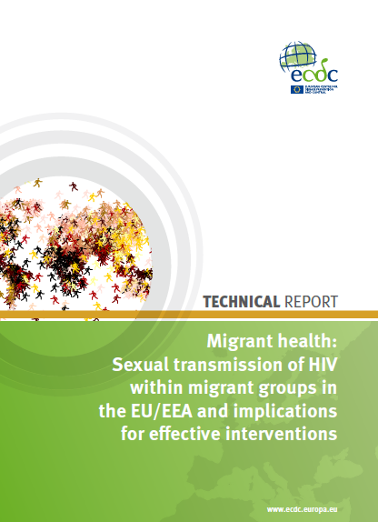
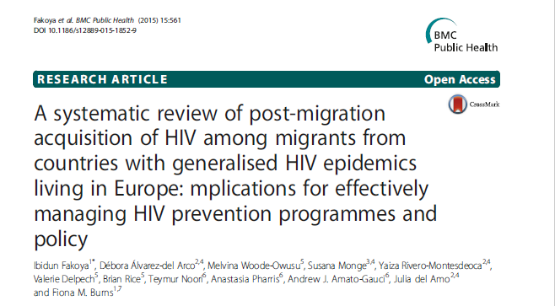
Where do migrants acquire HIV infection (prior to or after arrival to the EU)?

Slide 16
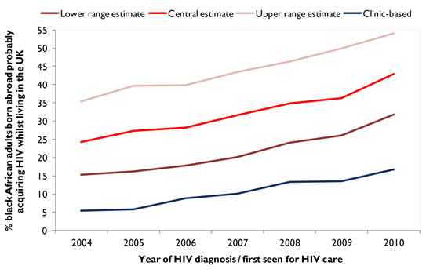
Where do migrants get infected with HIV (prior to or after arrival to the EU)?
Source: Rice BD, Elford J, Yin Z et al (2012). A new method to assign country of HIV infection among heterosexuals born abroad and diagnosed with HIV in the UK. AIDS 26 (15): 1961-6
Clinic-based estimate CD4-based estimate
18%
7%
Source: Rice BD, Elford J, Yin Z et al (2012). A new method to assign country of HIV infection among heterosexuals born abroad and diagnosed with HIV in the UK. AIDS 26 (15): 1961-6

Slide 17
Where do migrants get infected with HIV (prior to or after arrival to the EU)?
Source: Rice BD, Elford J, Yin Z et al (2012). A new method to assign country of HIV infection among heterosexuals born abroad and diagnosed with HIV in the UK. AIDS 26 (15): 1961-6
Clinic-based estimate CD4-based estimate
46%
24%
18%
7%
Source: Rice BD, Elford J, Yin Z et al (2012). A new method to assign country of HIV infection among heterosexuals born abroad and diagnosed with HIV in the UK. AIDS 26 (15): 1961-6

Slide 18
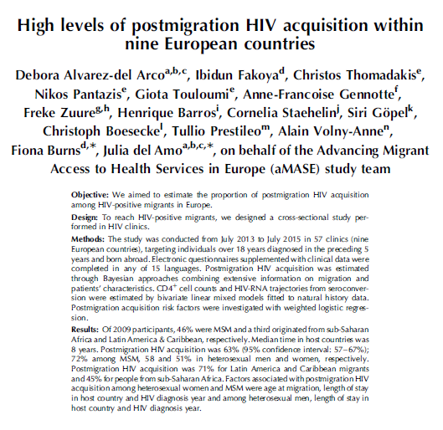
Source: Alvarez del-Arco, et al. High levels of post-migration HIV acquisition within nine European countries. AIDS, 2017.

Slide 19
Post-migration HIV acquisition (n=2249)
Why is this important?
Screening newly arrived migrants at point of entry is not enough
Some sub-populations of migrants are at-risk for HIV acquisition many years after arrival to the EU
Countries should develop and deliver targeted primary HIV prevention programmes to migrant populations at risk
Including for those visiting friends and relatives
Source: Alvarez del-Arco, et al. High levels of post-migration HIV acquisition within nine European countries. AIDS, 2017.

Slide 20
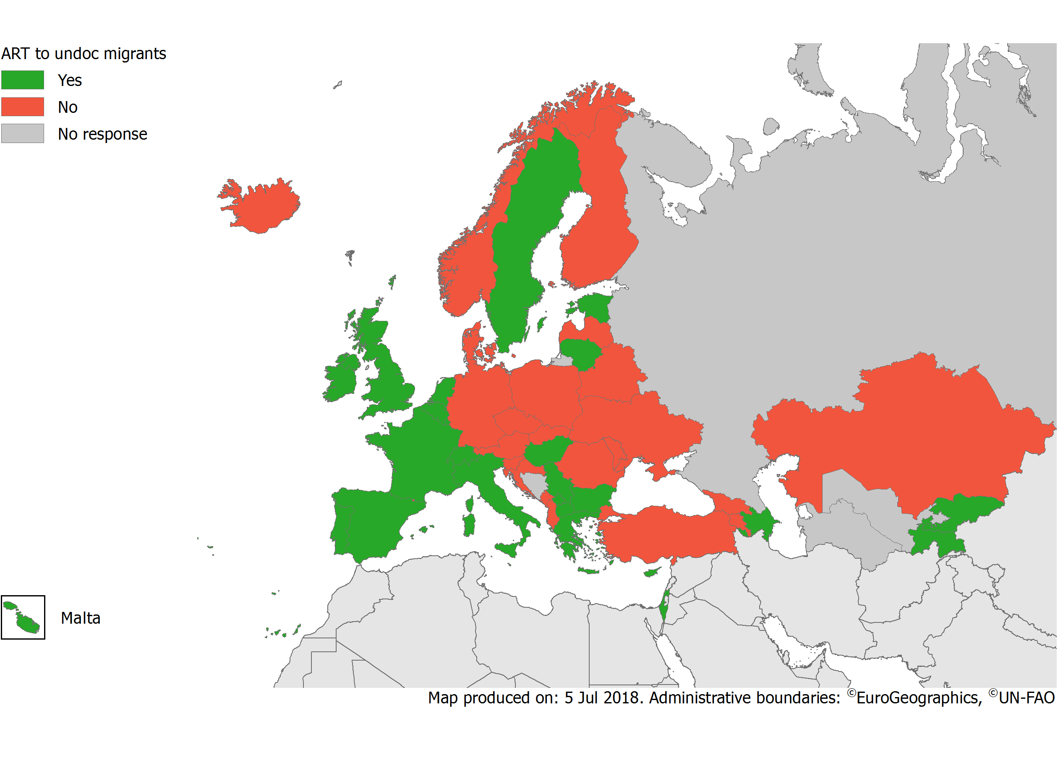
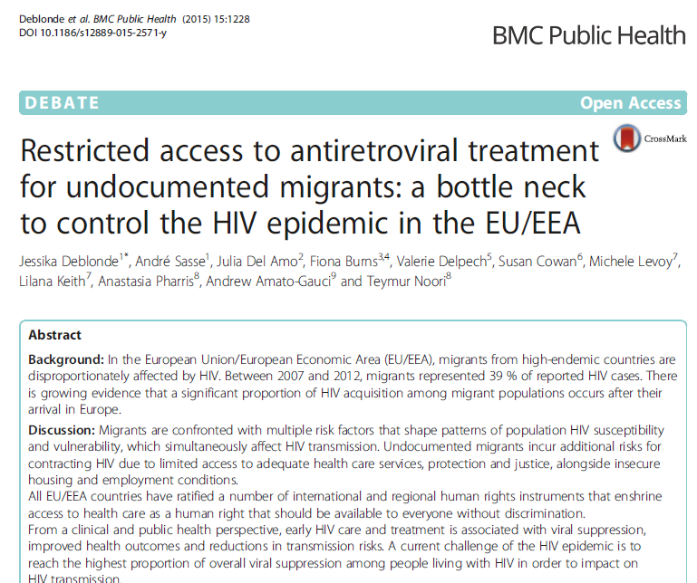
Availability of ART for undocumented migrants
2018
Source: ECDC. Dublin Declaration monitoring 2018; validated unpublished data.

Slide 21
TB

Slide 22
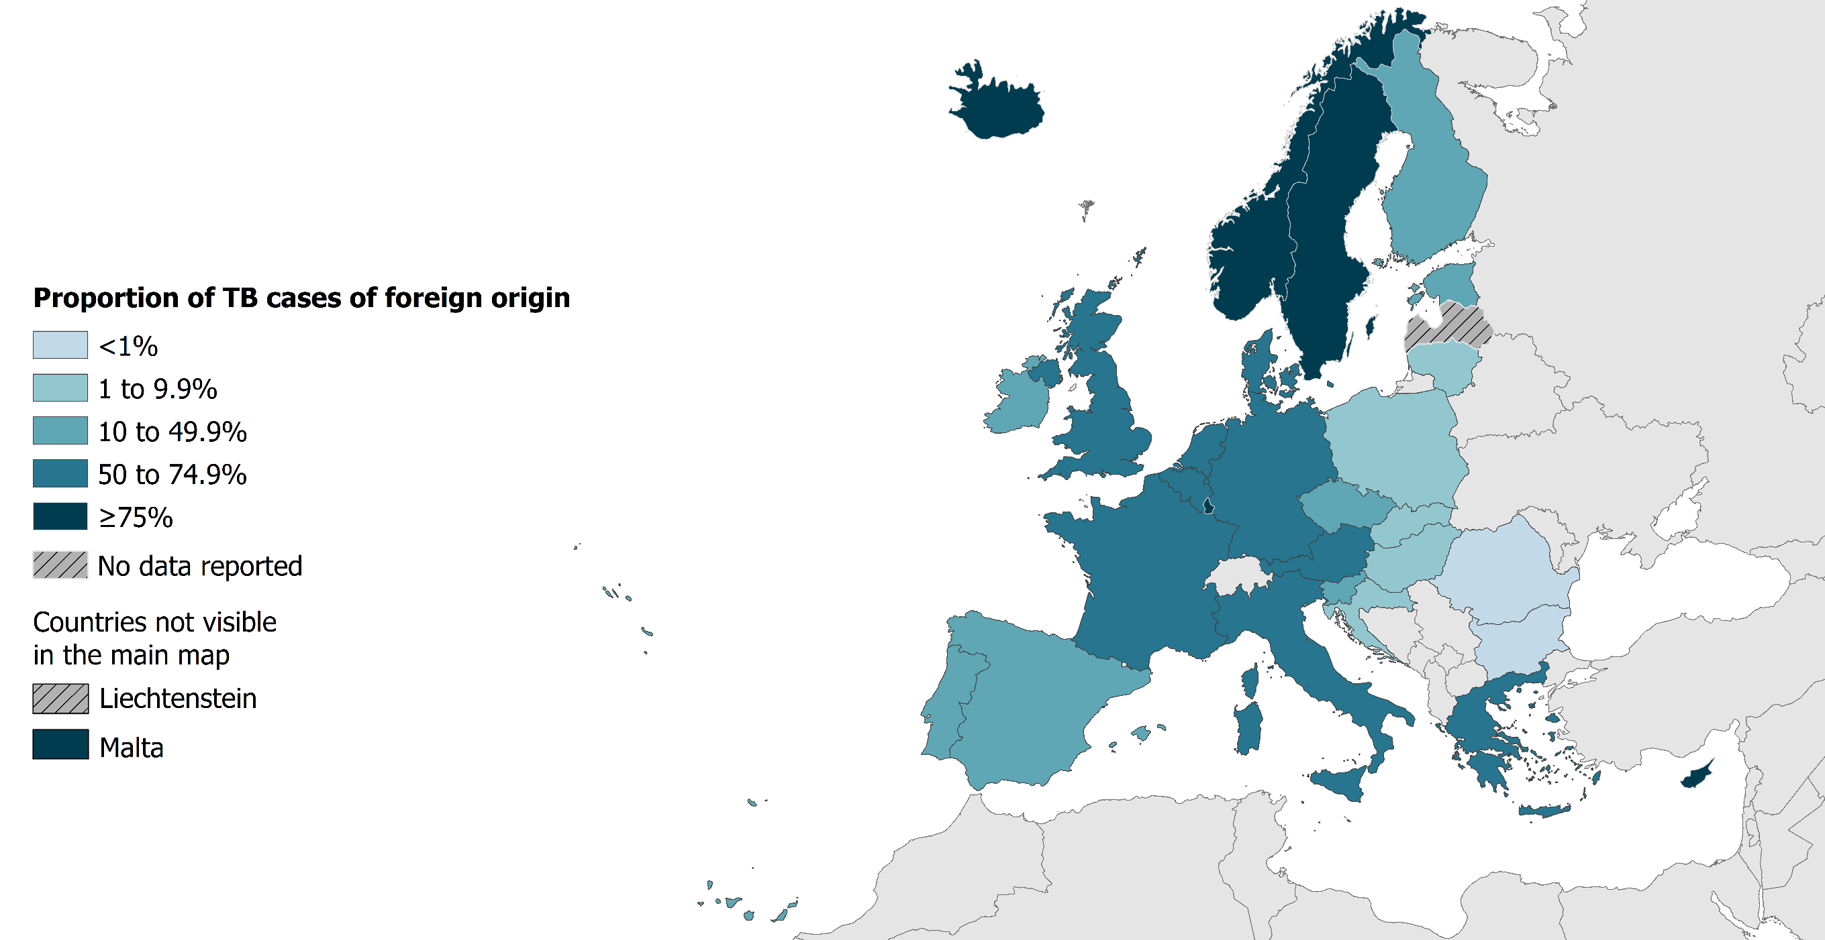
TB in persons of foreign origin*, EU/EEA†, 2019
17 181 TB cases of foreign* origin
34.5% of all TB cases (range 0.0–95.9%)
* Notified in persons originating from other countries than the reporting country. † Latvia and Liechtenstein did not report data for 2019.
Source: ECDC/WHO (2021). Tuberculosis surveillance and monitoring in Europe 2021–2019 data

Slide 23
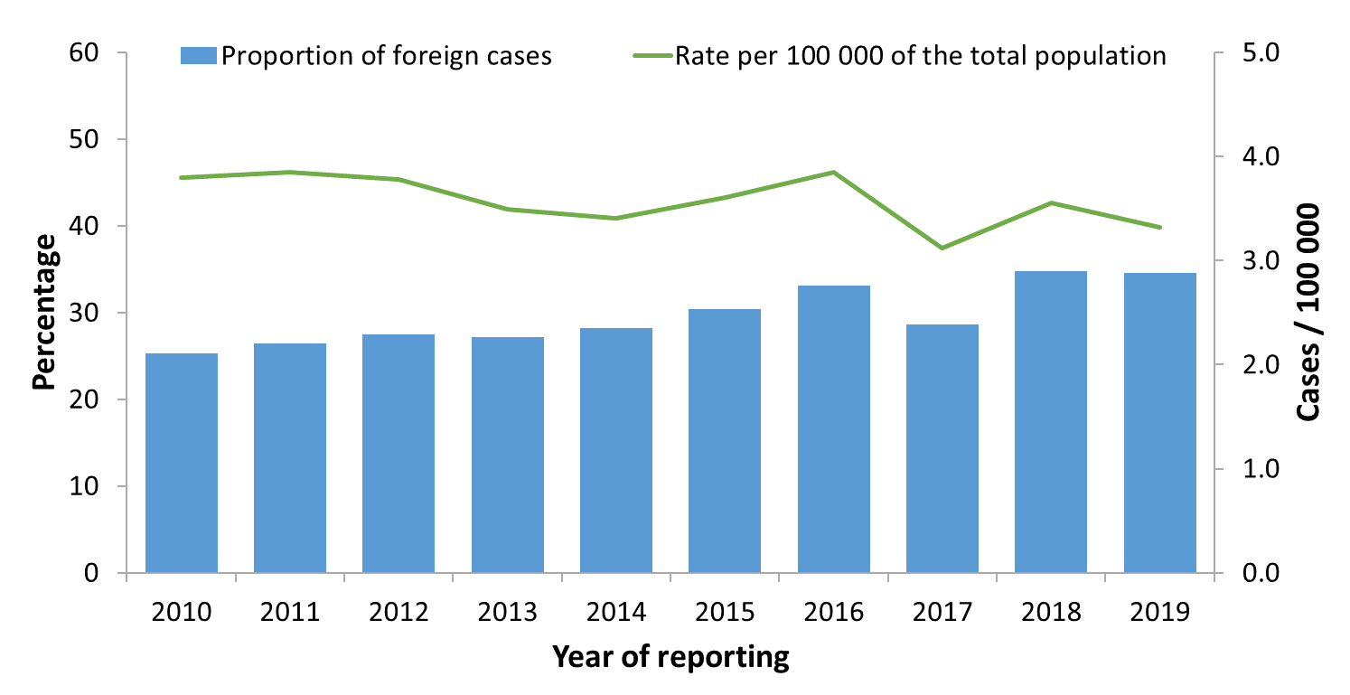
TB cases in persons of foreign origin*, EU/EEA†, 2010–2019
The proportion of cases in persons of foreign origin increased from 25.3% in 2010 to 34.5% in 2019
The rate of TB cases of foreign origin per 100 000 of the total population varied between 3.1 and 3.9
* Notified in persons originating from other countries than the reporting country. † Croatia is not included for 2012. Latvia did not report data for 2018 or 2019. Liechtenstein did not report data for 2019.
Source: ECDC/WHO (2021). Tuberculosis surveillance and monitoring in Europe 2021–2019 data

Slide 24
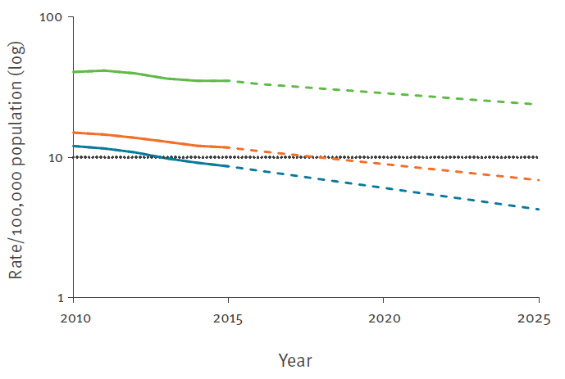

TB notification rates by origin and year, EU/EEA, 2010-2015
‘End TB 2035’ target
Notes:
The TB notification rate decreased at an annual rate of 5.3%. The decrease in notification rate was higher in native residents (7.0%) than in those of foreign origin (3.7%).

Slide 25
TB notification rates by origin and year, EU/EEA, 2010-2015
‘End TB 2035’ target
Notes:
The TB notification rate decreased at an annual rate of 5.3%. The decrease in notification rate was higher in native residents (7.0%) than in those of foreign origin (3.7%).

Slide 26
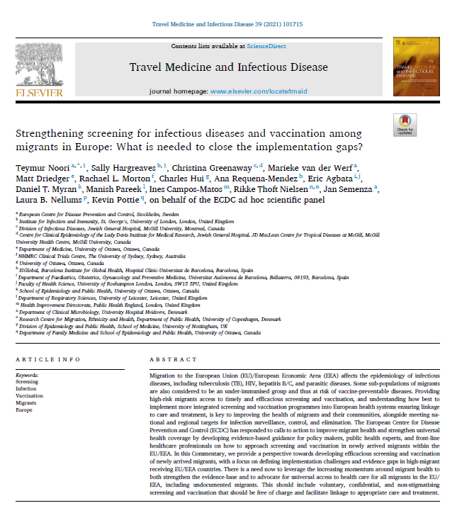
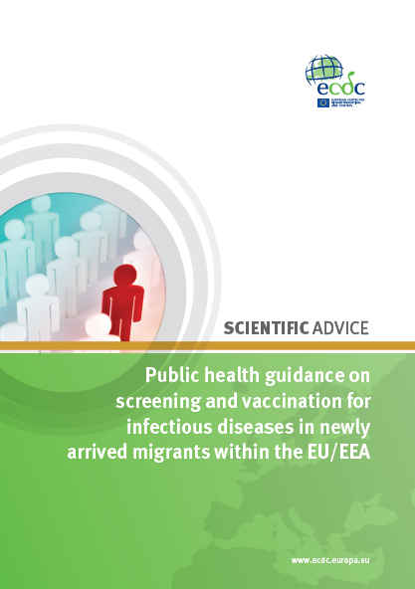
Evidence-based guidance on screening and vaccination of infectious diseases among newly arrived migrants in the EU/EEA

Slide 27
Priority conditions in ECDC guidance
Active TB
Latent TB
HIV
Hepatitis B
Hepatitis C
Intestinal parasites
Schistosomiasis
Strongyloidiasis
Routine vaccinations
Measles • Diphtheria
Mumps • Tetanus
Rubella • Pertussis
Hib • Polio

Slide 28
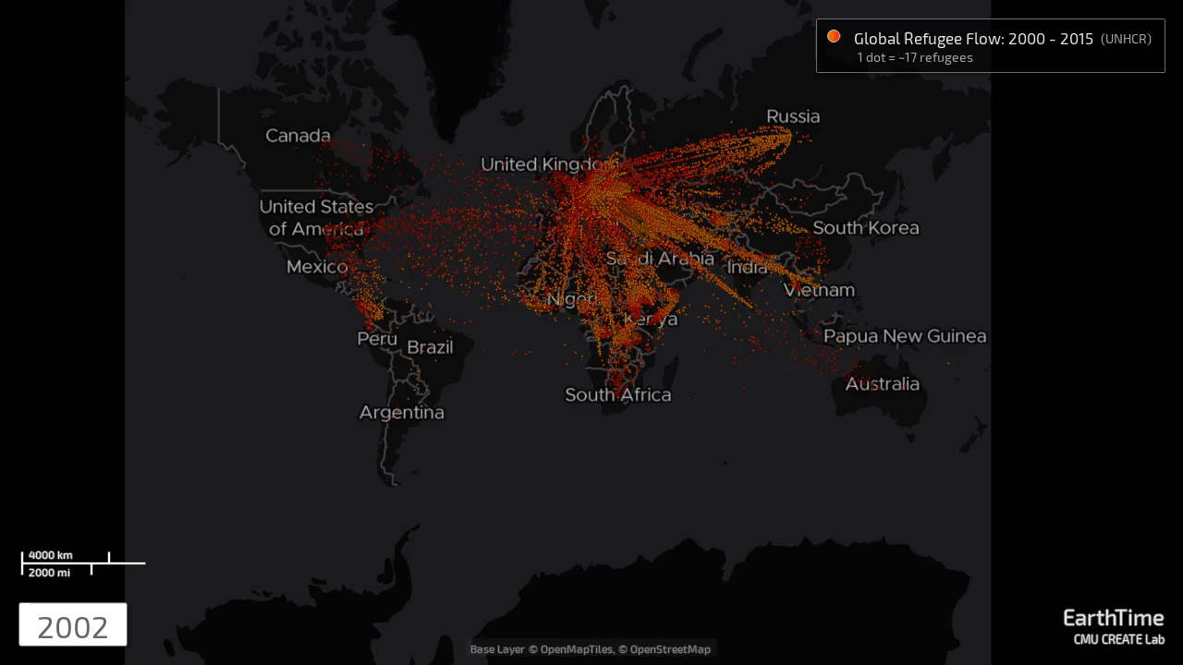
Refugee flows from 2002-2015
https://earthtime.org/stories/global_refugee_crisis_the_big_picture

Slide 29
Top 10 countries of births of immigrants and top 10 nationalities of asylum seekers (average 2014-2016)
Top 10 countries of birth of immigrants to the EU/EEA*
Top 10 origins (nationalities) of asylum seekers in the EU/EEA
 | EU/EEA
Total | 1,226,859 | %
Syria | 94,356 | 8
China | 83,883 | 7
India | 77,002 | 6
Morocco | 50,469 | 4
United States | 43,132 | 4
Pakistan | 35,764 | 3
Ukraine | 35,384 | 3
Moldova | 29,606 | 2
Russia | 24,976 | 2
Brazil | 24,915 | 2
Other | 727,371 | 59
 | EU/EEA
Total | 1,037,378 | %
Syria | 270,728 | 26
Afghanistan | 137,500 | 13
Iraq | 99,930 | 10
Pakistan | 41,447 | 4
Albania | 39,595 | 4
Nigeria | 38,535 | 4
Eritrea | 31,682 | 3
Iran | 28,159 | 3
Kosovo | 27,200 | 3
Russia | 18,121 | 2
Other | 304,482 | 29
Important to give primary healthcare workers and policy makers an indication of which infectious diseases are prevalent in the countries of origin, which can guide screening efforts at countries of destination
*Covering 56% of non-EU/EEA immigrants
Source: Eurostat migr_asyappctza

Slide 30
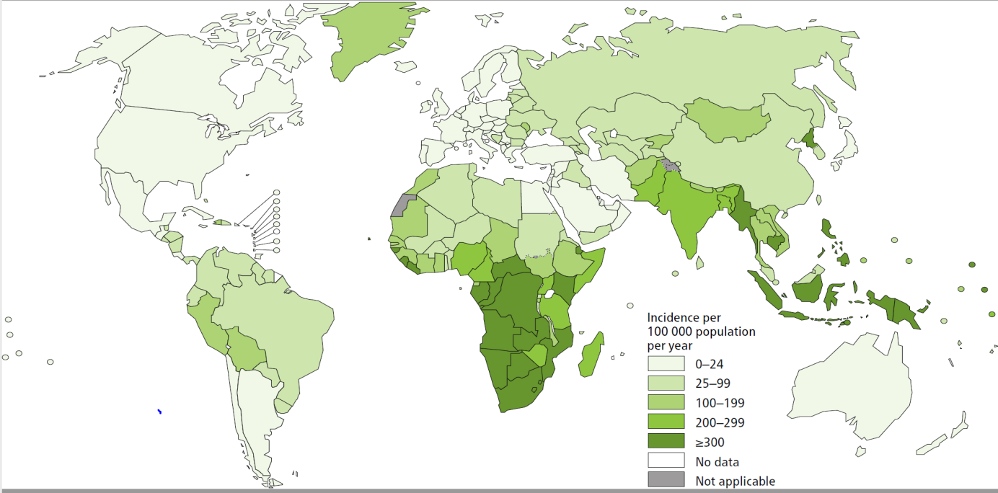
Burden of disease: TB
Figure 2. WHO global map of TB incidence
Source: Global tuberculosis report 2017. Geneva: World Health Organization; 2017.

Slide 31
Conclusions
Most migrants entering the EU/EEA are healthy, but some sub-groups of migrants carry a disproportionate burden of infectious diseases and may have lower vaccination coverage depending on country of origin
Major gaps in the scientific literature as to the effectiveness and cost-effectiveness of screening and vaccination of migrant communities
Available evidence suggests that:
It is likely to be both effective and cost-effective to screen migrants for active TB and LTBI, HIV, HCV, HBV, strongyloidiasis and schistosomiasis
There is a clear benefit to enrolling migrants in vaccination programmes as per national guidance
However, this is conditional on the burden of disease in migrants' countries of origin
Consensus on the need for free screening, vaccination and care for key infectious disease for all migrants in the EU/EEA, including undocumented migrants

Slide 32
COVID-19 and migrants

Slide 33
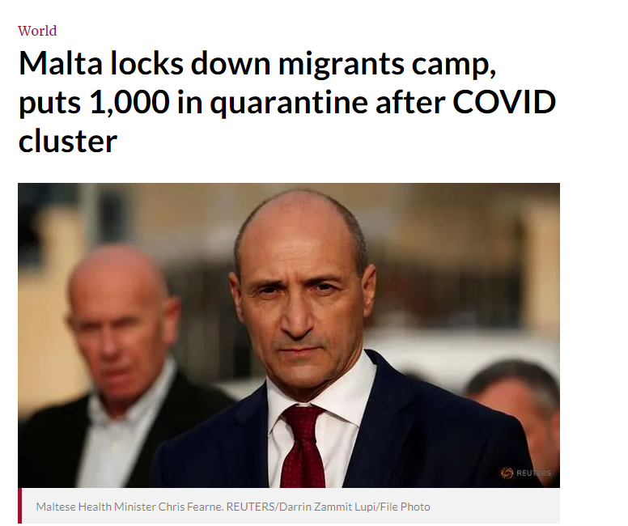
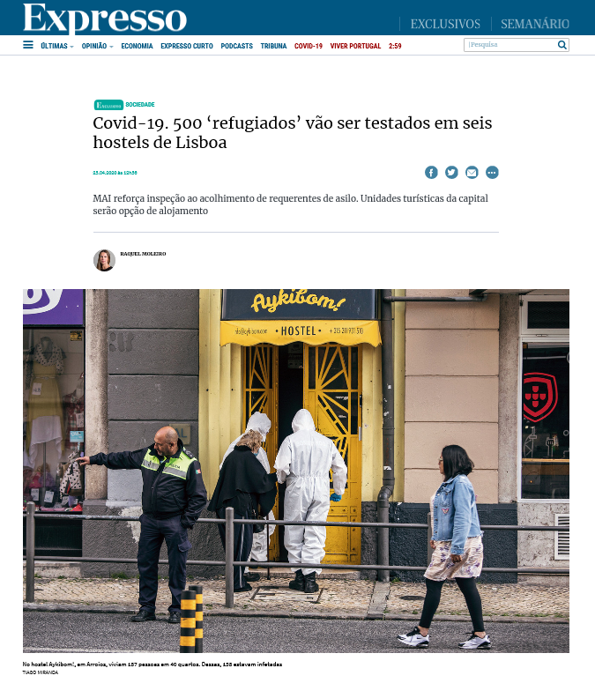
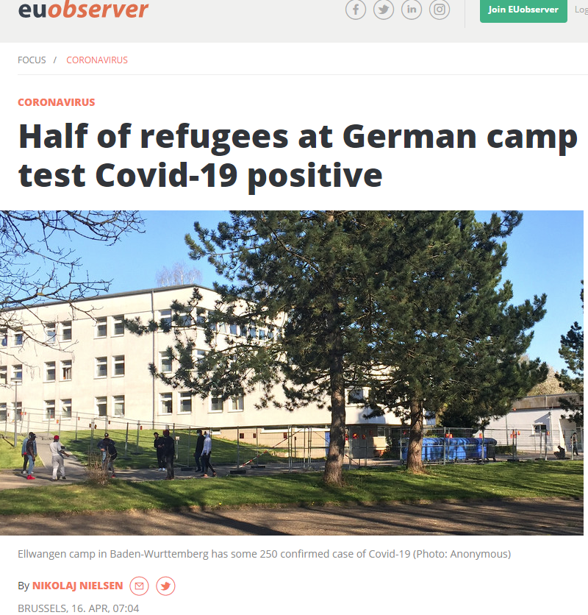
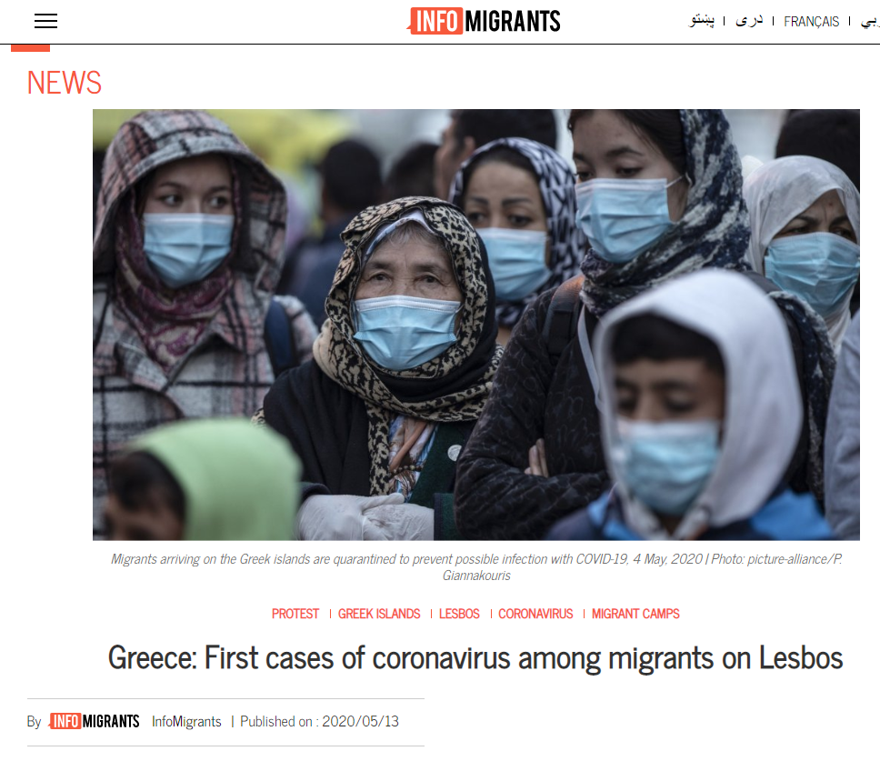
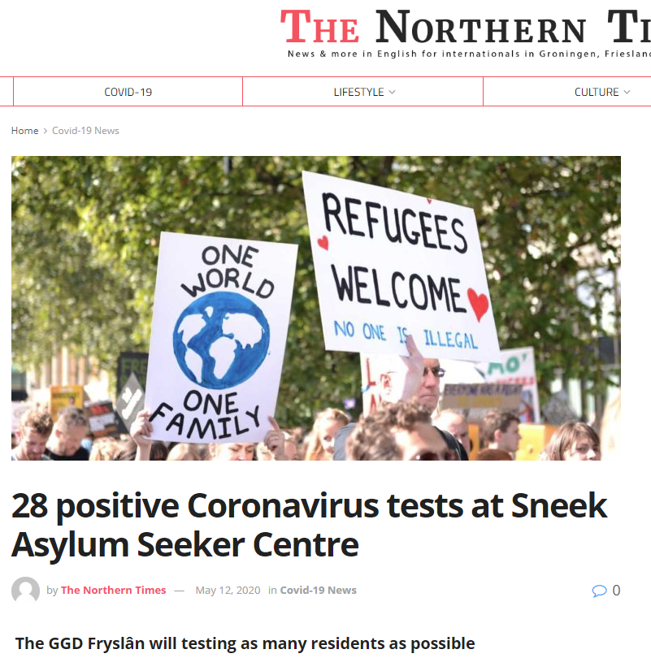
Outbreaks of COVID-19 in migrant reception centres

Slide 34
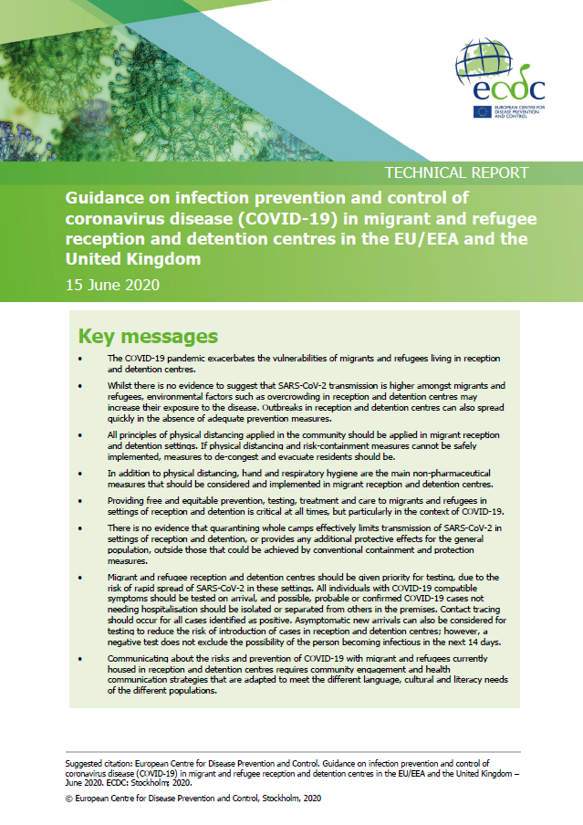
Source: ECDC (https://www.ecdc.europa.eu/en/publications-data/covid-19-reception-and-detention-centres-migrants-and-refugees)

Slide 35
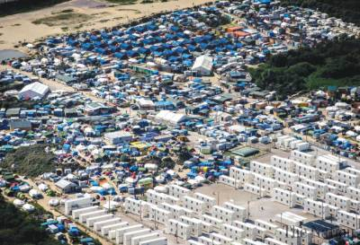
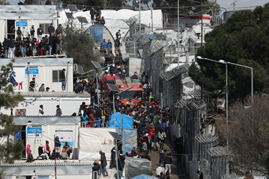
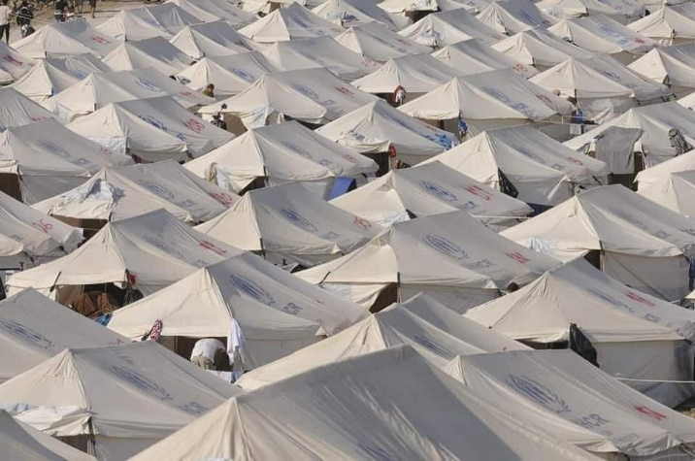
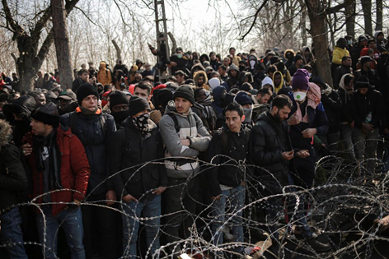
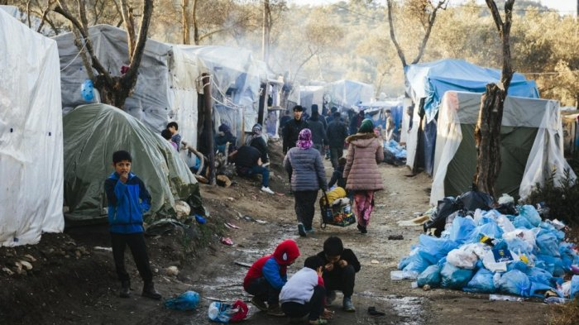
Key messages
The COVID-19 pandemic exacerbates the vulnerabilities of migrants and refugees living in reception/detention centres
Whilst there is no evidence to suggest that SARS-CoV-2 transmission is higher amongst migrants and refugees, environmental factors such as:
poor hygiene facilities
lack of physical distancing opportunities
overcrowding
may increase their exposure to the disease
Source: ECDC (https://www.ecdc.europa.eu/en/publications-data/covid-19-reception-and-detention-centres-migrants-and-refugees)

Slide 36
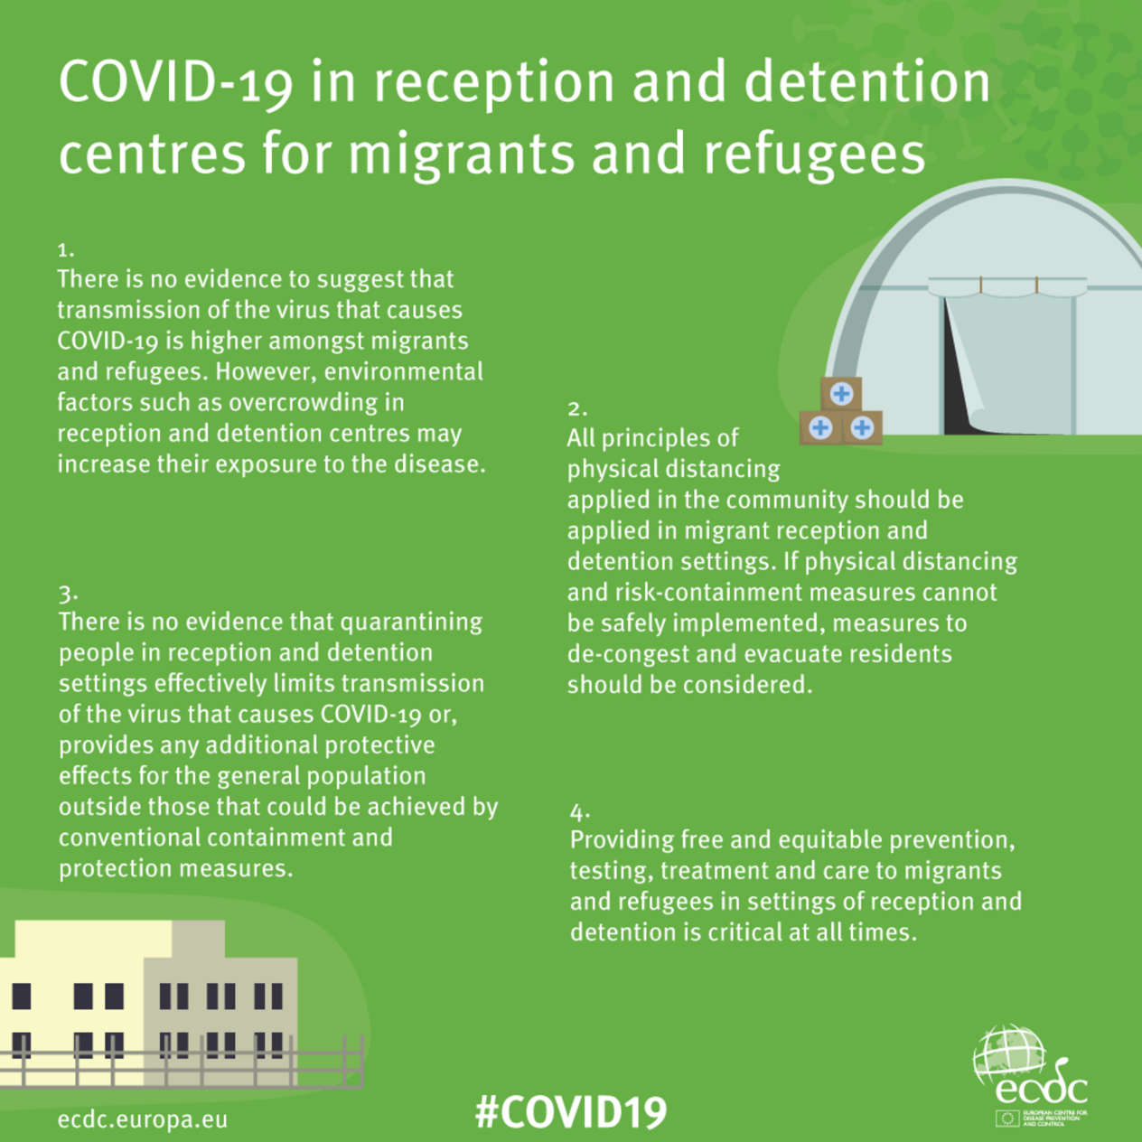
Key messages
All principles of physical distancing applied in the community should be applied in migrant reception and detention settings
If physical distancing and risk-containment measures cannot be safely implemented, measures to de-congest and evacuate residents should be considered
There is no evidence that quarantining whole camps effectively limits transmission of SARS-CoV-2 in these settings
Source: ECDC (https://www.ecdc.europa.eu/en/publications-data/covid-19-reception-and-detention-centres-migrants-and-refugees)

Slide 37
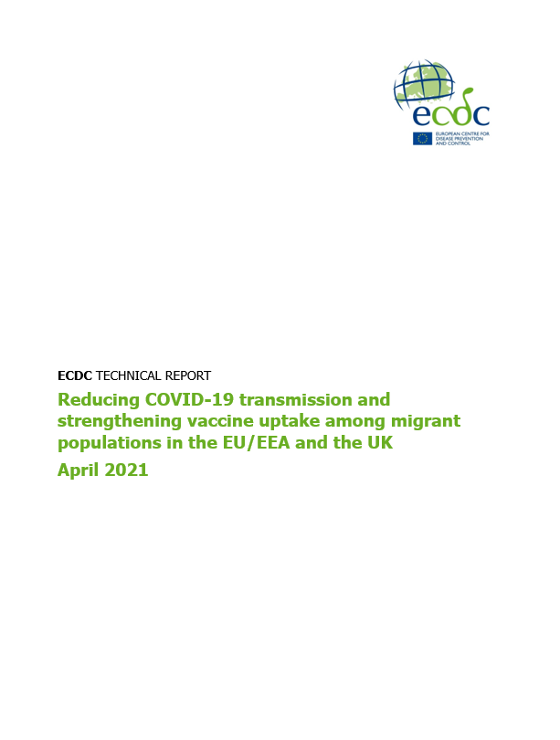
NEW ECDC report on COVID-19 and migrants/ethnic minorities
There is evidence that some migrant communities may be at high risk of exposure to, and infection with, COVID-19, and that they are disproportionately represented in cases and deaths
Some migrants may be at higher risk of exposure due to factors that may include: occupational risk, overcrowded accommodation, and lower levels of accessibility to public health services
Culturally and linguistically relevant preventative measures should be put in place for migrant groups, as well as effective communication of risk and prevention messages
Consideration must be given to ensuring equitable access to and uptake of tests for COVID-19, and for the COVID-19 vaccine, particularly in migrants excluded from health systems

Slide 38
Acknowledgments
ECDC colleagues
Marieke van der Werf, Erika Duffell, Anastasia Pharris, Marlena Kaczmarek
Migrant screening guidance team
Kevin Pottie, Chis Greenaway, Chuck Hui, Rachel Morton, Ana Requena, Eric Agbata, Daniel Myran, Beverly-Ann Biggs, Jessica Dunn, Tamara Lofti, Elie Akl, Joerg Meerpohl, Al Mayhew, Olivia Magwood, Prinon Rahman, Tatum McLeod, Robin Christensen, William Stauffer, Nick Rowbotham, Luisa Menjivar Ponce, Anh Tran, José Muñoz, Pablo Alonso-Coello, Alberto Matteelli, David Ingleby, Moneeza Walji, Vivian Welch, Ted McConnell, Brittany Scarfo, Ted McConnell, Holger J Schünemann
Scientific panel members
Angel Kunchev, Gabrielle Jones, Anna Kuenhe, Andreas Gilsdorf, Agoritsa Baka, Apostoles Veizis, Lelia Thornton, Silvia Declich, Francesco Castelli, Pierluigi Lopalco, Michael Vonk, Maria van den Muijsenbergh, Irene Veldhuijzen, Maria Axelsson, Sonia Dias, Henrique Barros, Manuel Carballo, Katherine Russell, Ines Campos-Matos, Dominik Zenner, Manish Pareek, Rebecca Hall, Isabel de la Mata, Olga Gorbacheva, Joao Pires, Ludovica Banfi, Cliona M Cheallaigh
Special thanks to
Sally Hargreaves, Laura Nellums, David Ingleby

Slide 39
Thank you
teymur.noori@ecdc.europa.eu

Slide 40
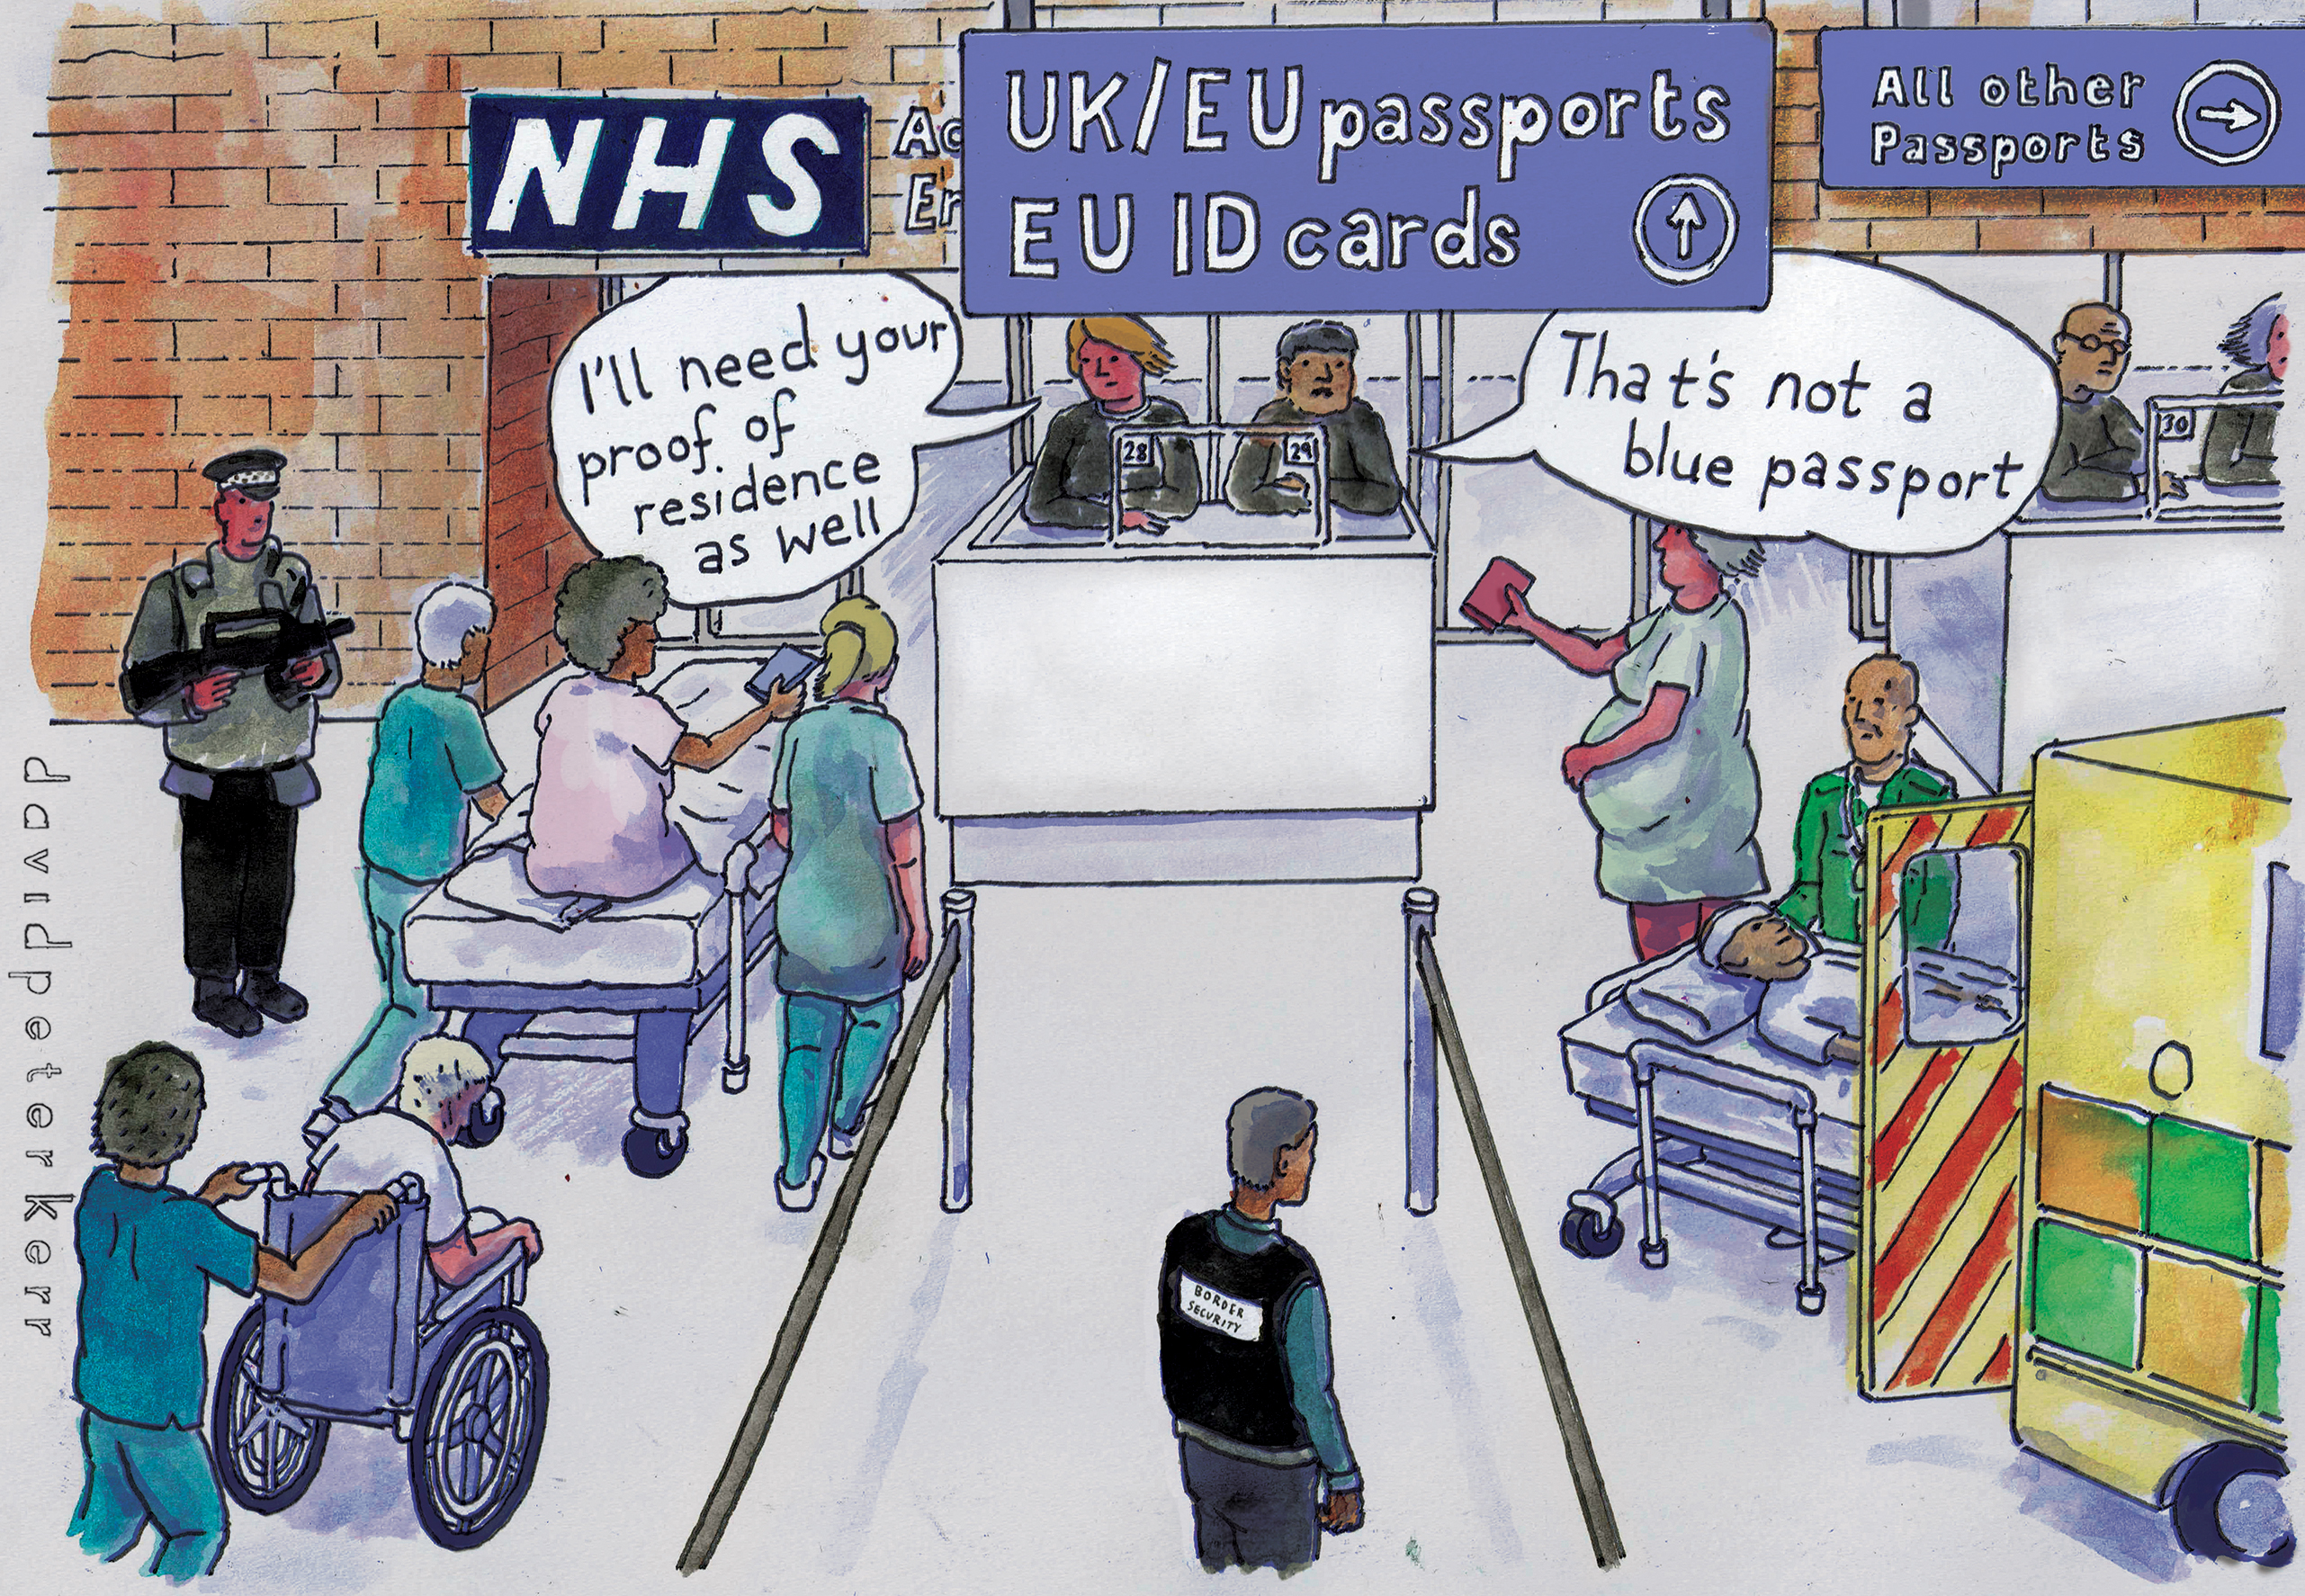
Hostile Europe:
TB, migration & healthcare
@DrJessPotter
North Middlesex University Hospital
Jessica.potter3@nhs.net
Notes:
I was given the title of this talk ‘New country, new TB’ but actually this isn’t a new country, the socio-political landscape I will describe is not one we haven’t seen before and TB is anything but a new disease.

Slide 41
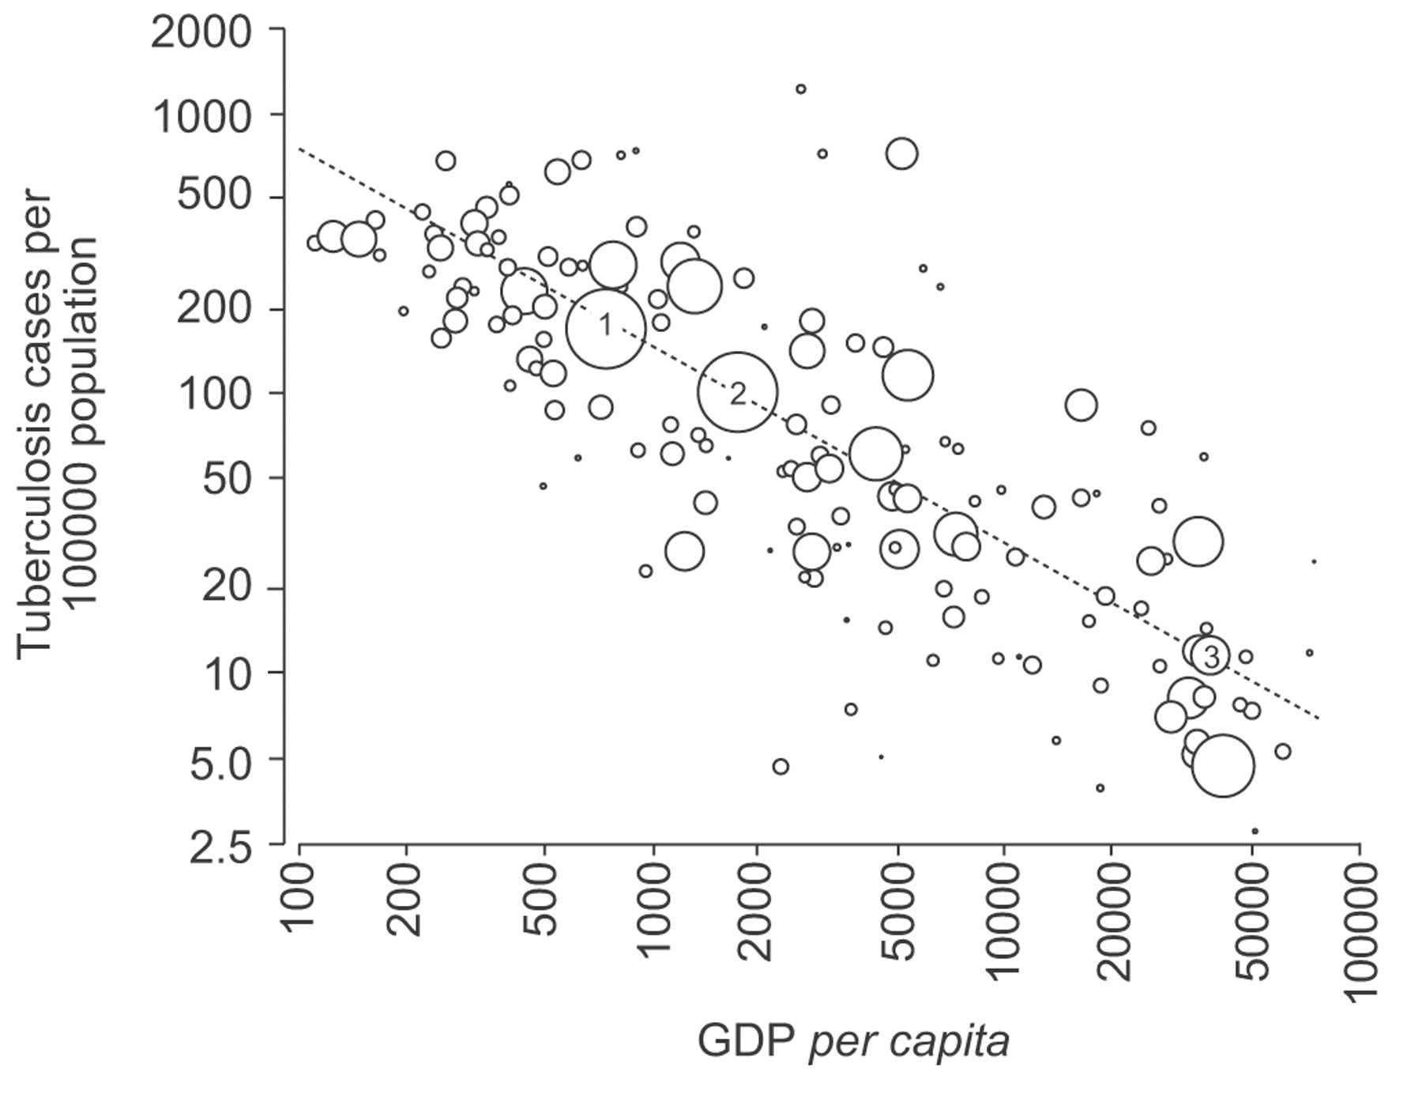
Janssens & Rieder, ERJ 2008
Notes:
TB is inextricably linked to poverty both on a global scale

Slide 42
Rate of TB by deprivation decile, England, 2019
Most deprived 10% of the population
Least deprived 10% of the population
Source: Enhanced Tuberculosis Surveillance system (ETS), Index of Multiple Deprivation (IMD 2019)
Data extracted: March 2020
Prepared by: TB Unit, National Infection Service, Public Health England
Notes:
And a national one.

Slide 43
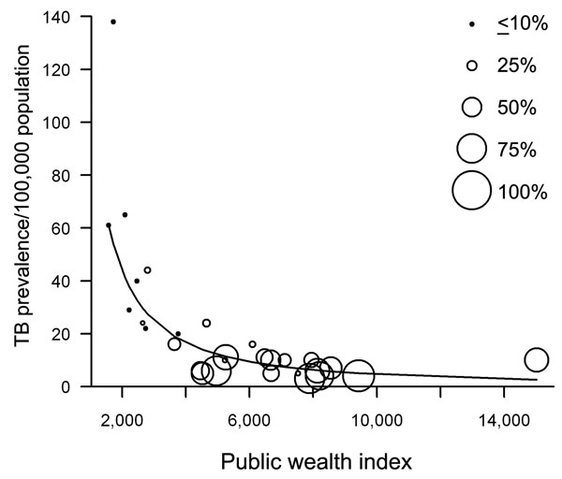
Public wealth index and tuberculosis prevalence rates in the 27 European Union. Each circle represents a country and the size indicates the proportion of TB cases which were foreign-born within that country
(Suk et al., 2009)
Notes:
Within the EU, richer countries have a larger proportion of their TB cases occurring among people who were originally born abroad.

Slide 44
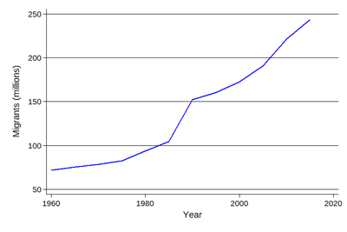
Notes:
Globally, the numbers of people migrating each year has been climbing steadily for many years. We migrate for a multitude of reasons driven by a desire to thrive or simply, to survive. While migrating to find work may be required for survival, so-called ‘economic’ migrants are frequently pitched as less deserving than people fleeing war or political persecution. In reality, such dichotomies are rarely clear cut and frequently result in harm, for example, through exclusion from health systems.

Slide 45
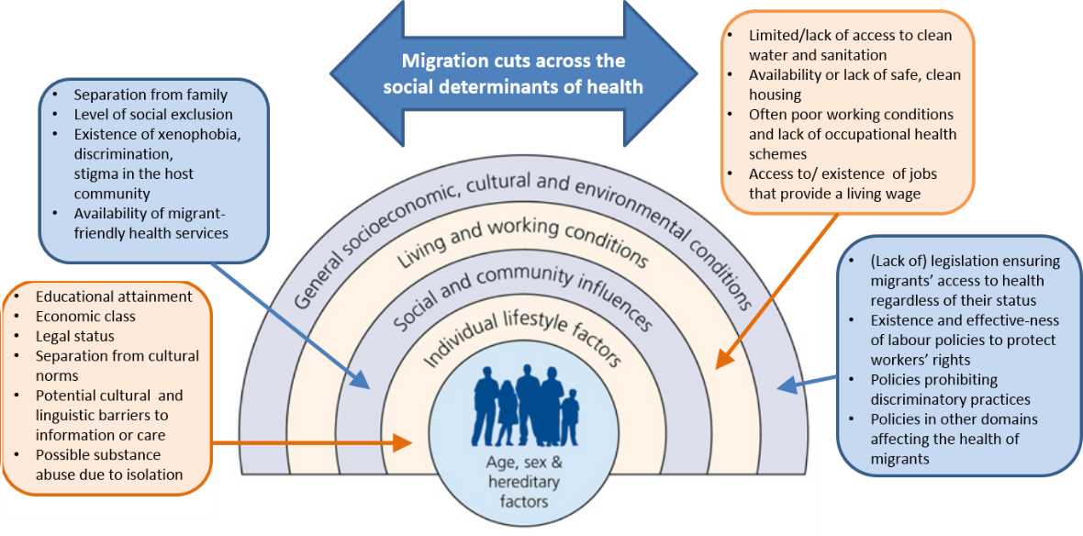
Dhavan et al. 2017
Notes:
Migration cuts across all of the social determinants of health. Experiences before, during and after migration contribute to a person’s risk of developing TB and their experience of having their health care needs fulfilled if they get it.
Within high income, low TB burden countries TB is often positioned as being carried by ‘immigrant bodies’ against which the host population must be protected.
This is clearly highly relevant to current discourse about COVID-19 with discussions of closing borders, vaccine passports and hotel quarantines. In the next section I will reveal how some of these restrictive border policies cause harm – harms which impact both individual health but also international attempts to eliminate TB.

Slide 46
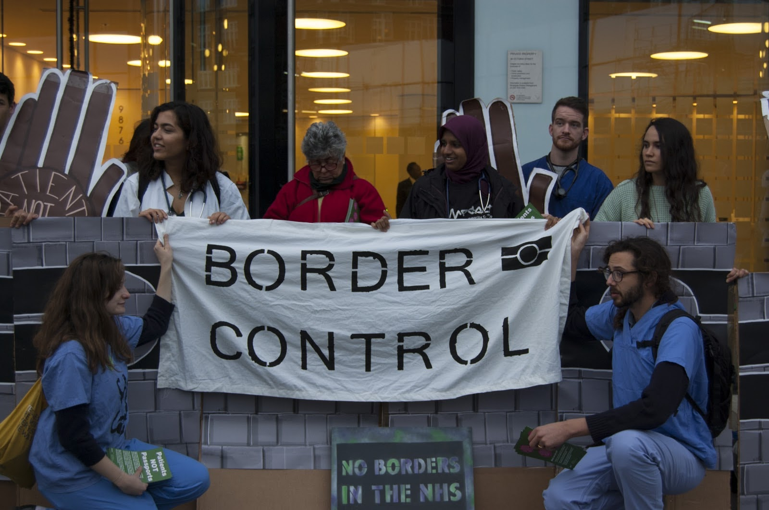
At the border

Slide 47
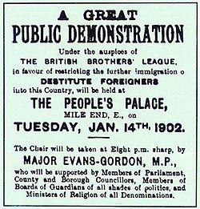
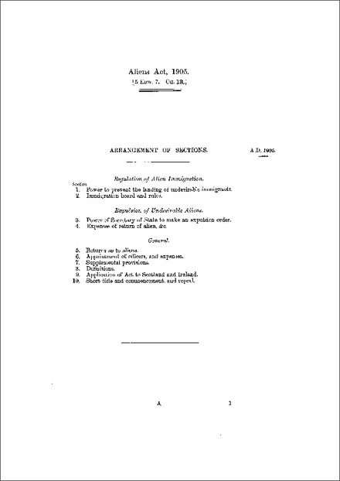
Notes:
Screening for infection in general and TB in particular among immigrants is not a new phenomenon.
Even at the turn of the 20th century, concerns around immigration were used to institute the Aliens Act 1905 which sought to control the passage of infected bodies into England.

Slide 48
Pareek et al. 2016
Notes:
Screening exists for latent TB infection and active TB disease – particularly infectious pulmonary disease. This can occur at a number of different points along a person’s migratory journey including before migration.
My research sought to understand how people subject to pre-entry screening experienced it from their own perspective. I therefore conducted a focused ethnography of a pre-entry screening TB centre in India.
A Public Health England employee told me that pre-entry screening for TB was a quote ‘normal policy’ used quote ‘not for exclusion but rather to ensure that people are treated properly” End quote
Such framing of policy concerns - using the language of healing - directs inquiry towards questions of how policies might govern better or heal more rather than asking why govern, who is governed and what is the impact of such government.

Slide 49
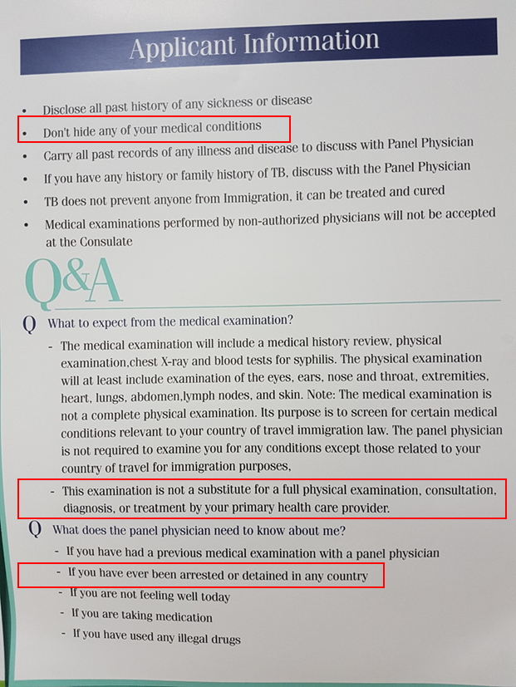
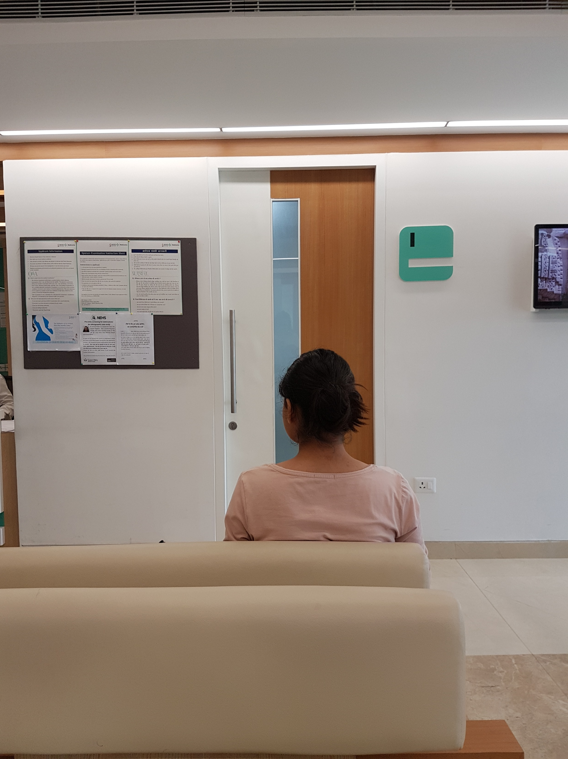
Notes:
What does this process look like?
Dr Latif calls the client’s name who comes in and sits down silently. There is no smiling, no introductions. The client is a young girl of about 19 – a student perhaps. Dr Latif asks the girl if she has had any contact with TB, any past history of TB or any other lung disease? No she replies. Sit up on there, he says pointing up on the couch. He ticks some boxes and signs the form. He quickly listens to her front, back and axillae. He looks at her x-ray report and slides her form towards her. ‘Sign here,’ he says, tapping the form. He looks back at the computer. ‘Is that it?’ she asks. He replies, ‘Just fill in these details, take it to the front desk where you got the form and they will stamp it.’ She gets up and walks out.
Posters warn people not to ‘hide anything’ and highlight the fact this is not a substitute for seeing your usual doctor.
The fact this is not care delivery is underscored further by the head of the clinic on the first day who says to me – quote - ‘Patients, sorry - clients - we must not call them patients’.
These ‘clients’ are then examined by doctors whose duty of care is confused – are they serving their profit-demanding employers, the British government or their patients?

Slide 50
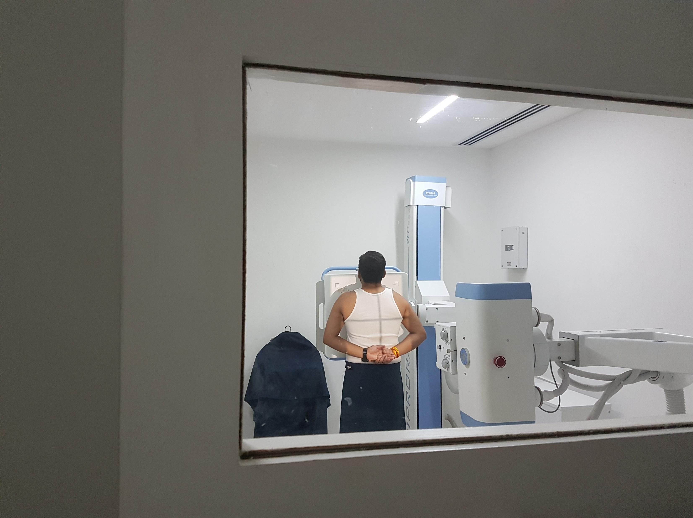

“it's kind of making mark for like all the Asian”
Notes:
The people I interviewed revealed their sense of harm and injustice
Jason described feeling ‘marked’ as ‘other’ by the pre-entry screening process.
Faisal pointed out who isn’t screened:
Quote ‘But sorry, just I want to mention one thing – if you’re visiting the UK, for example if you’re on a tourist visa or you’re just visiting family for short stay then you don’t have to undergo that TB test.’ End quote. This amounts to 500,000 people per year. In addition, if you migrate from a country with lots of TB inside the EEA, like Romania, currently you are not screened.

Slide 51
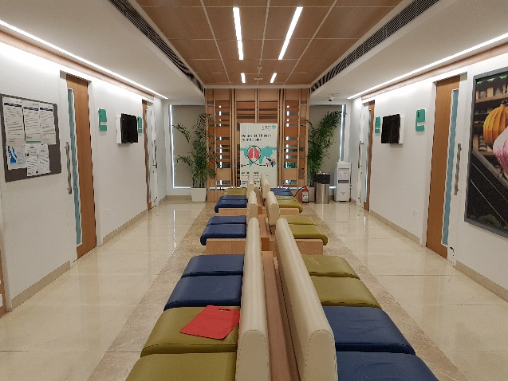
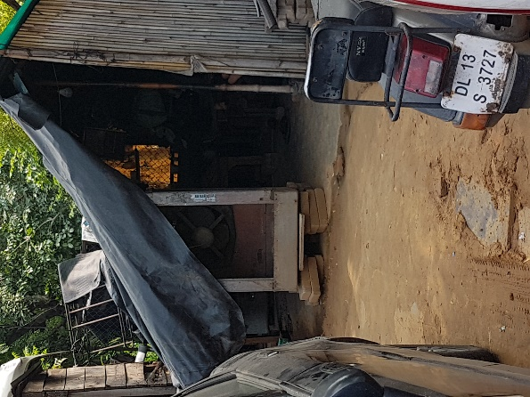
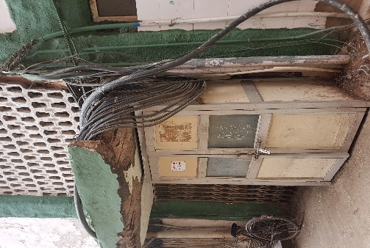
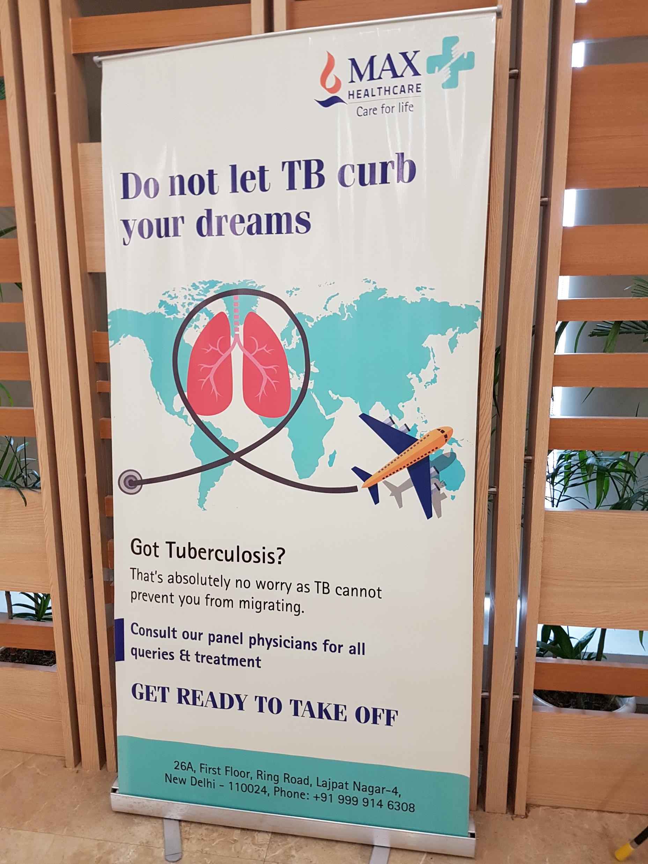
Notes:
You may have heard recently of the phrase ‘enlightened self-interest’ – used by Jeremy Farrar – head of the Wellcome Trust talking about the UK’s responsibility to ensure vaccines are available globally and not just the wealthy countries.
Similarly in TB, policy-makers & other commentators argue that pre-entry screening not only benefits the recipient country bringing, for example, valuable infrastructure such as laboratory testing. From my perspective the corporate glamour of the clinic stood in stark contrast to the road outside and the city’s public hospital. UK-bound clients wore the latest fashions, carried mobile phones and laptops while many of the people I could see on the streets below, slept in shacks at the side of the road or walked around in bare feet. There is a stark difference in incidence of TB between these two populations within India.
Positioning pre-entry screening programmes in terms of a mutual benefit distracts from the unequal starting positions of donor and recipient countries in terms of both relative wealth, and TB burden.

Slide 52
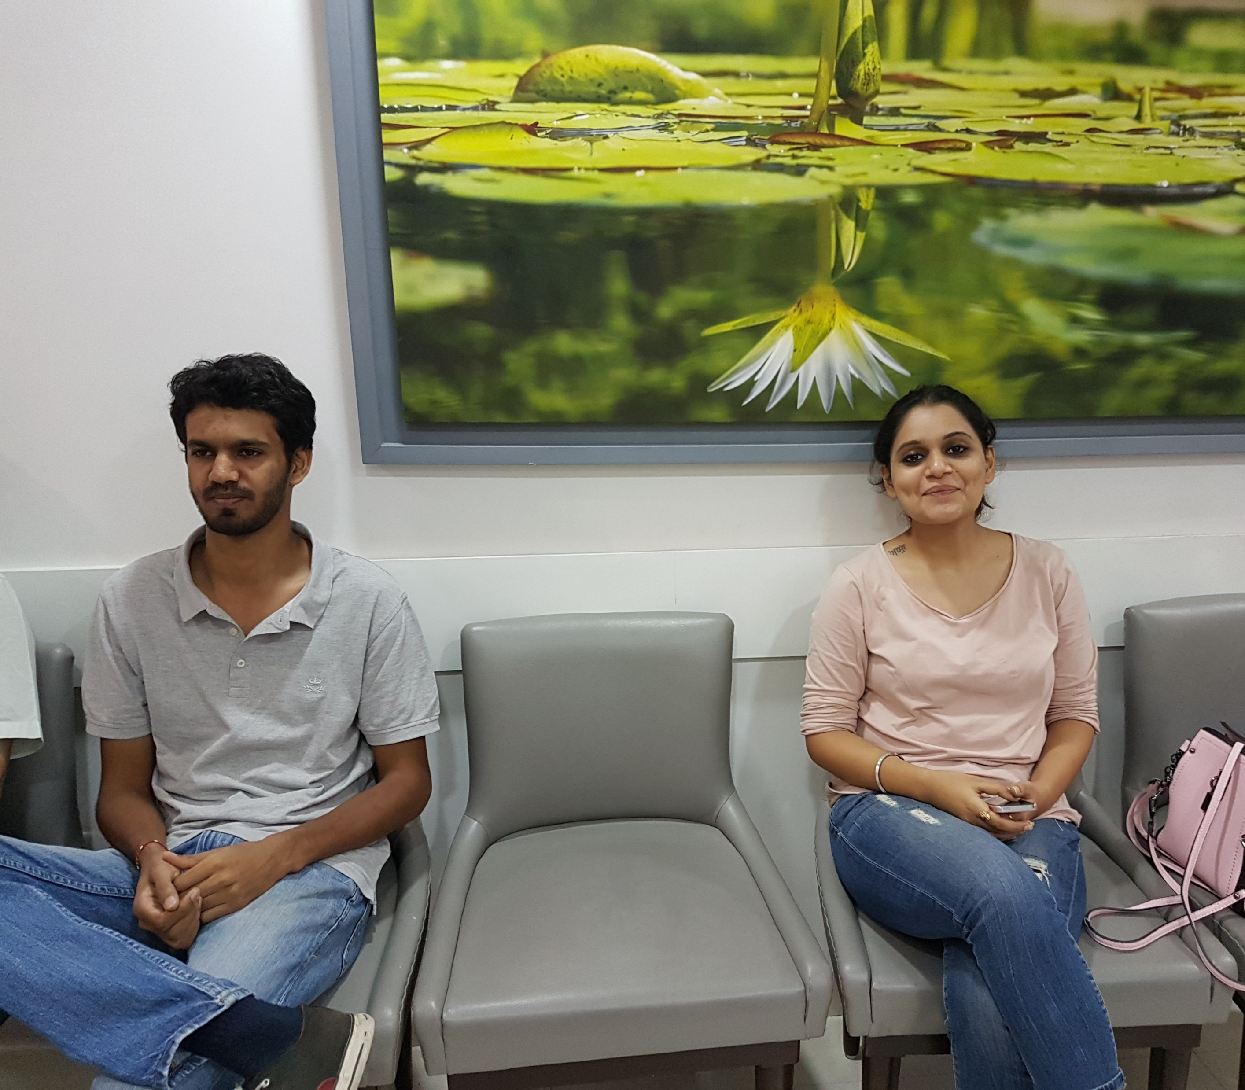

Notes:
UK clients in the immigration centre did not resemble the people I could see on the streets below, some of whom slept in shacks at the side of the road or walked around in bare feet. UK clients wore the latest London fashions (off the shoulder tops with flared sleeves), had designer (knock-off or otherwise) handbags, carried the latest mobile phones and occasionally worked on laptops as they waited to be seen. Most spoke excellent English and many were coming to the UK to study where they would pay fees upwards of £15,000 per year to attend university. Even just the cost of a flight to the UK at the time of the research was the same as the average annual income of a person living in India. Both on a global scale and within individual countries, TB is inextricably linked to poverty. The people the UK government define of as ‘at-risk’ with regard to pre-entry screening policy are not therefore ‘at-risk’ on a national scale but an international one.

Slide 53
Notes:
Contrary to this large poster from the waiting room, clients described how the process placed their lives on hold. University places were lost and marriages cancelled. One woman not only lost out on a job opportunity but had to move our children from their home to be closer to the testing centre and then got stuck there all of them separated from the father because he had to start his job in the UK while she completed 6 months of TB treatment – all this pain despite the fact she was smear negative at diagnosis.
And so, through the ‘biosecuritisation’ of some, but not all, off-shore bodies; some, but not all, off-shore TB; some, but not all, infectious diseases; pre-entry screening becomes a selectively permeable border force, reinforcing global inequities and racialised hierarchies – placing UK lives above those of ‘others’.

Slide 54
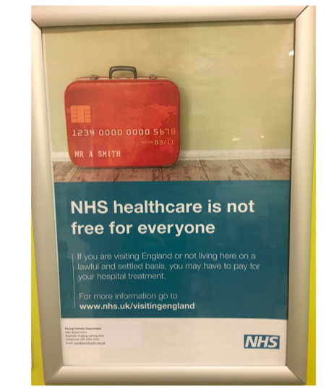
Healthcare access
Notes:
Health services, their provision and how people access care in order to have their health needs met are another important social determinant of health.

Slide 55
“Barriers to equity of access and quality of care undermine the assumption that because the NHS is free to all then it is equally available to all.”
Professor Raj Bhopal
Notes:
You might think that in the UK, nobody should have a problem accessing healthcare but as epidemiologist Raj Bhopal points out ““Barriers to equity of access and quality of care undermine the assumption that because the NHS is free to all then it is equally available to all.”

Slide 56
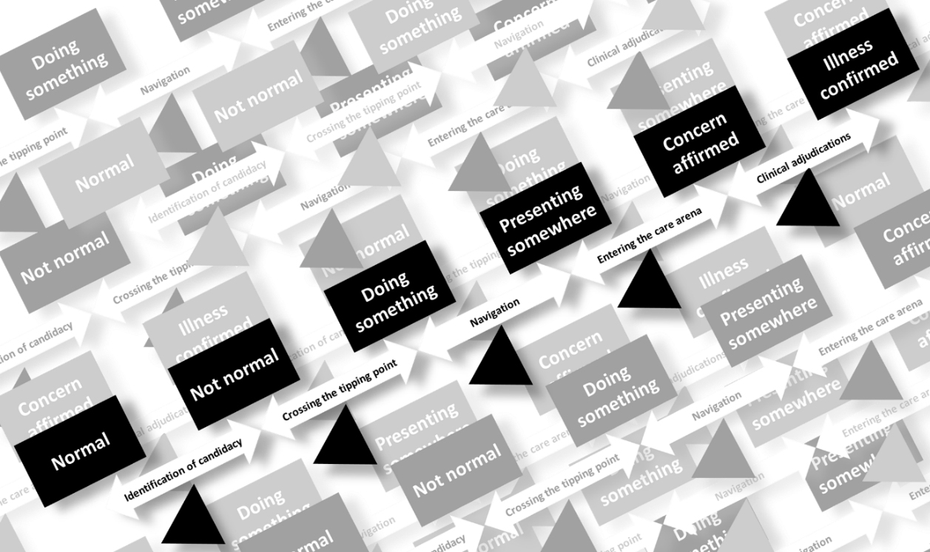
TB: The trek to treatment
Notes:
Healthcare access is a complex social process shaped by who individuals are, their resources and the people, places, policies and practices they encounter. The ‘trek to treatment’ for TB patients requires work.

Slide 57


Socio-political ‘milieux’
Patriarchal societies
Capitalism, neoliberalism
Structural racism
Biomedicine
Xenophobia
Notes:
Some of the conditions which shape people’s experience of healthcare access are listed here. While the examples I am about to provide represent a ‘hostile environment’ specifically directed towards migrants, conditions intersect, as do the experiences of individuals and so, in a UK context at least, we cannot talk of xenophobia without speaking about structural racism, for example.

Slide 58
Amendments to the NHS Charging Regulations Who no longer counts as ordinarily resident?
Undocumented migrants and failed asylum seekers excluded
Students and non-EEA residents moving to work in the UK excluded (Anyone without indefinite leave to remain)
Upfront charging for non-urgent treatment is introduced
EU citizens without settled status will be chargeable in the event of a no-deal Brexit. (People with pre-settled status will be chargeable).
2004
2015
2015
2017
2021
Yates et al. 2007 Medicine Conflict and Survival
Potter JL. 2019 Justice Power and Resistance
Notes:
Over the course of the last 15 years access to the NHS has become increasingly limited beginning in 2004 with the exclusion of undocumented migrants and failed asylum seekers.

Slide 59
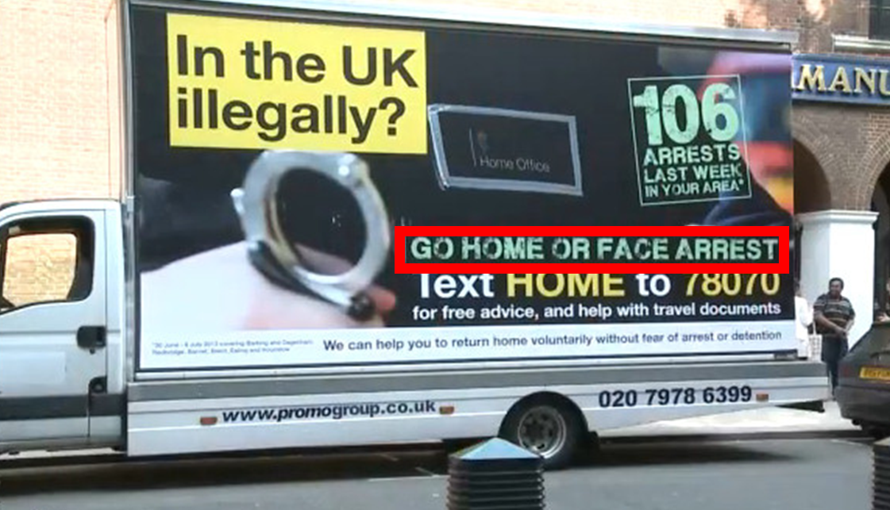
Notes:
In 2011, Teresa May, then Home Secretary announced she was gong to create a really hostile environment for people coming to the UK without the legal right to do so. This hostile environment spanned access to housing, banking, driving as well as healthcare.

Slide 60
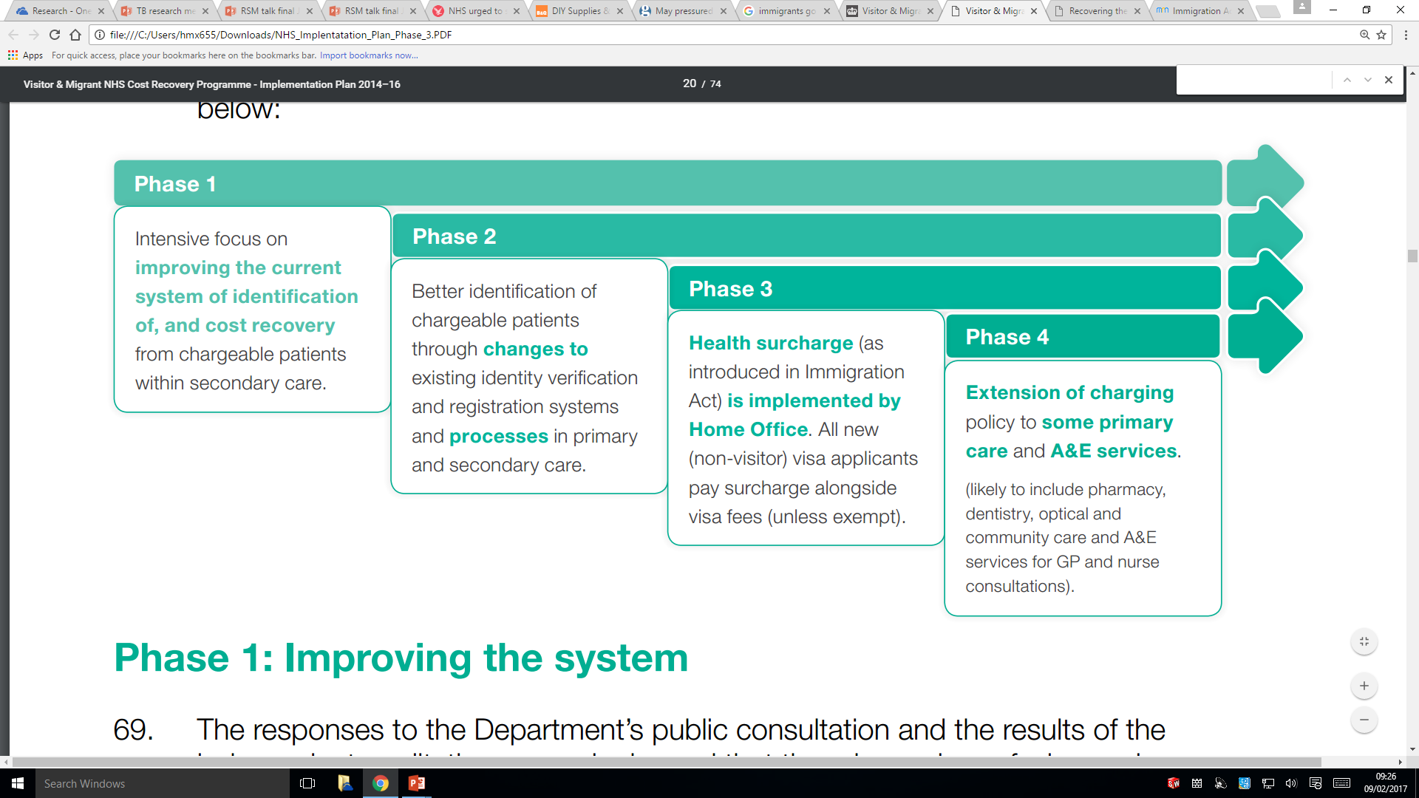
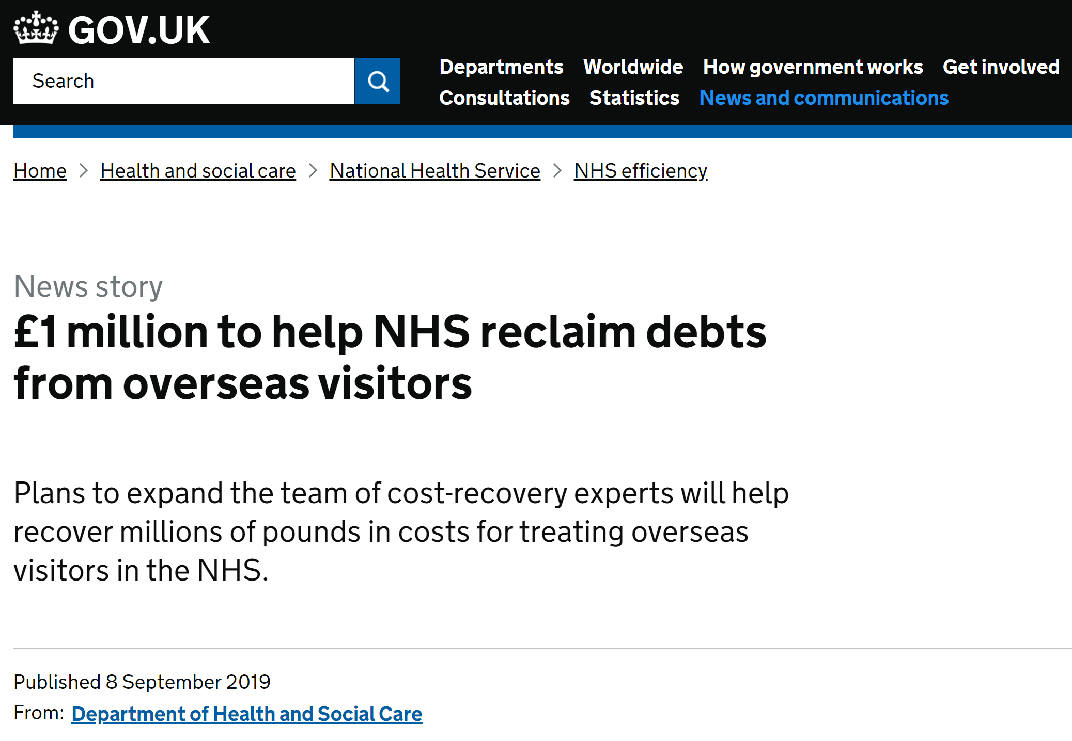

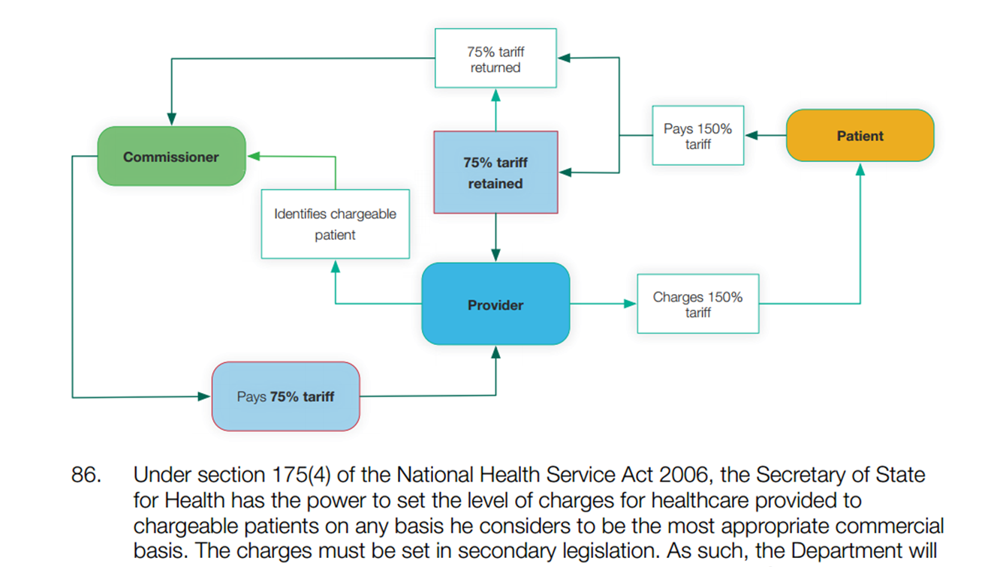

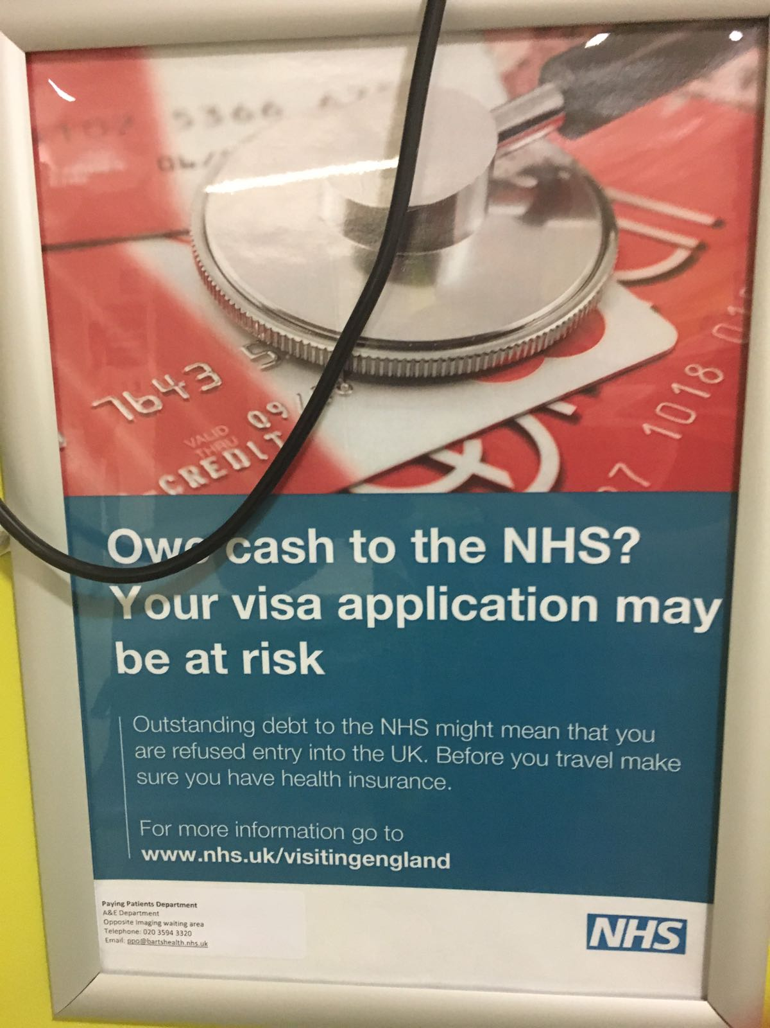
Migrant and visitor cost recovery programme Implementation Plan 2014-2016
April 2014
October 2014
NOT ELIGIBLE
April 2015
IMMIGRATION HEALTH SURCHARGE
£400 per person
per year
October 2017
CHARGE = 150% COST
Notes:
In the health service this manifested as a series of policy-changes. Surveillance methods such as a traffic light system banner of eligibility was added to the NHS spine database which holds patient demographic information. In addition an 80p per minute hotline between the home office and the NHS allowed determinations of eligibility in more difficult cases and data sharing to facilitate deportation. Charges for healthcare were increased to 150% of cost to incentivise billing and bailiffs were sent after people who did not pay. Healthcare workers were told it was their duty to report and threatened with prosecution for fraud if they did not.

Slide 61

Data sharing
Deters health-seeking:
Threat to individual health
Threat to public health
Threat to public health surveillance systems
Delayed care is more expensive care
Potter JL, Journal of Public Health 2017
Notes:
The existence of data sharing between immigration authorities and health systems is a significant deterrent to healthcare access. For infectious diseases like TB this is not only harmful to individuals but also potentially the public, as well as public health surveillance systems.

Slide 62



Notes:
While TB is exempt from Charging, as it is across many EU states, people do not walk around with a sign around their neck saying ‘I have got TB’ – they present with symptoms and not diagnoses. In addition, my research, 72 of 100 recent migrants to the UK with TB did not know TB care was free before they started treatment.

Slide 63
A threat to health?
Within-group comparison pre and post law change
Migrants treated after the introduction of the visitor and migrant cost recovery programme were 37% more likely to have a delay in diagnosis than those treated before.
OR 1.37 (95% CI, 1.13-1.66, p<0.0001)
Potter et al. 2020
BMC Public Health
P<0.001
p= 0.307
Notes:
Looking across a large retrospective cohort of over 3000 TB cases in East London, we showed there was an association between the role out of the Migrant & Visitor Cost Recovery programme with its embedded racist & xenophobic policies and practices and an increase in treatment delay among migrants.

Slide 64




Slide 65




















Thank you...
Notes:
Moving forward, we can and must do better at designing policies which challenge rather than uphold unjust systems, which aim for global rather than national elimination of TB and which, above all, position the well-being of the people we screen and treat upfront and centre.

Slide 66






Labor migration &
tuberculosis in Poland
Photos: internet
Olena Rzhepishevska, PhD

Slide 67







Work with Bacteria
& Metabolomics
Work & Health 2019 - 2020
Daniel Kashnitsky – independent expert

Slide 68

Europe - the Largest hub of international labor migration
ILO, 2018

Slide 69

WHO European Region – 53 diverse countries
TB new cases & relapses
2017

Slide 70

Ukrainians,
the largest group of labor migrants in Poland – global phenomenon (OECD, Outlook 2018)
Ukraine
Poland
Similar population size Similar language Similar culture

Slide 71
Ukraine - Poland
Labor migration timeline
2017 – 2020
visa-free entry to EU
for 90 days for Ukrainians
2020 - Germany opens for
Ukrainian labor workers
2014 - revolution
2008 - Ukrainians don’t need work permit in Poland but a “declaration”
2016 - labor migration
Ukraine - Poland peaks
2018 – more strict work
Regulations in Poland

Slide 72





TB country profiles (WHO) – Poland & Ukraine follow similar curve
Sweden - 10 mln people
Mortality - 4% (25)
Poland
37 mln people
Mortality - 8% (473)
28% of deaths from infections
Slope
Germany – 83 mln people
Mortality – 6% (313)
Ukraine
40 mln people
Mortality - 16% (5100)
Belarus - 9 mln people
Mortality – 11% (311)

Slide 73


Tuberculosis in Eastern & Western Poland
TB notification rates per 100 000 by voivodeships, Poland, 2019
Poland average 13,9
Belarus
Ukraine

Slide 74


Could labor migration be seen in the Poland’s TB profile?
N of declarations registered for Ukrainian citizens
5321
Timeline
2017 - 2020
Visa-free entry to EU
for 90 days for Ukrainians
2020 - Germany opens for
Ukrainian labor workers
2014 - Revolution
2008 - Ukrainians don’t need work permit in Poland but a “declaration”
2016 - labor migration
Ukraine - Poland peaks
2018 - new work regulations
OSW Report: www.osw.waw.pl/sites/default/files/Report_Migration%20from%20Ukraine_net.pdf

Slide 75



In the context of global TB targets

Slide 76


In the context of global TB targets
Projected decline of global TB incidence rates to target levels
5321
Matteelli A et al. Eur Respir Rev 2018;27:180035
Notes:
Projected acceleration in the decline of global tuberculosis (TB) incidence rates to target levels. Reproduced from [34] with permission.

Slide 77


Passive detection of TB in Poland
Work & Health
A
B
H
I
G
5321
E
C
D
K
F
J
L
C - Jagiellonian University Medical College
D - Krakow Municipality
www.igichp.edu.pl/wp-content/uploads/2020/06/biuletyn_2020.pdf
pubmed.ncbi.nlm.nih.gov/30860181/

Slide 78

Vulnerable groups
People living with HIV
>0,5% of country population
//pubmed.ncbi.nlm.nih.gov/32065811/
https://www.unaids.org/sites/default/files/country/documents/UKR_2019_countryreport.pdf

Slide 79
Conclusion
Labor migration from Ukraine to Poland might be seen in Poland’s TB country profile
Vulnerable groups may be affected when not covered by diagnostic /active case finding
What to do?
Offer free diagnostic and information to all labor migrants (not only from Ukraine)
Build contact between Ukrainian & Polish healthcare

